Slide 1
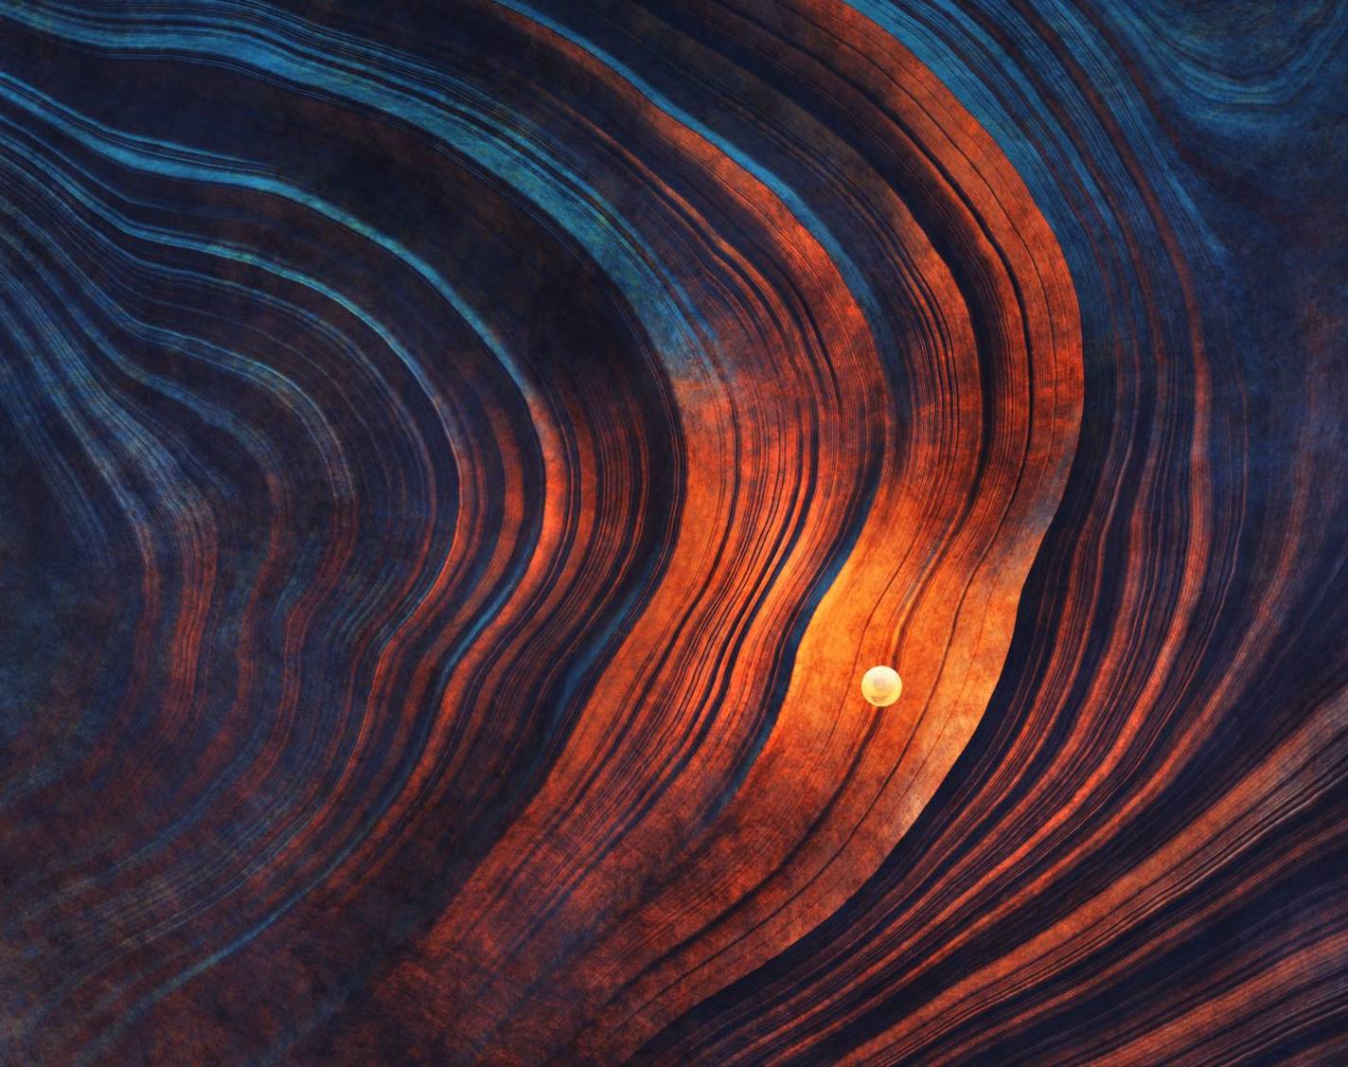

AMUSE Asteroids
Tünde Meijer, Kutay Nazli, Claire Olde Loohuis
December 14th, 2022

Slide 2
Presentation Overview
Relevant Physics
Scientific Justification
Project Overview
AMUSE Overview
Interesting Results

Slide 3
Presentation Overview
Relevant Physics
Scientific Justification
Project Overview
AMUSE Overview
Interesting Results

Slide 4
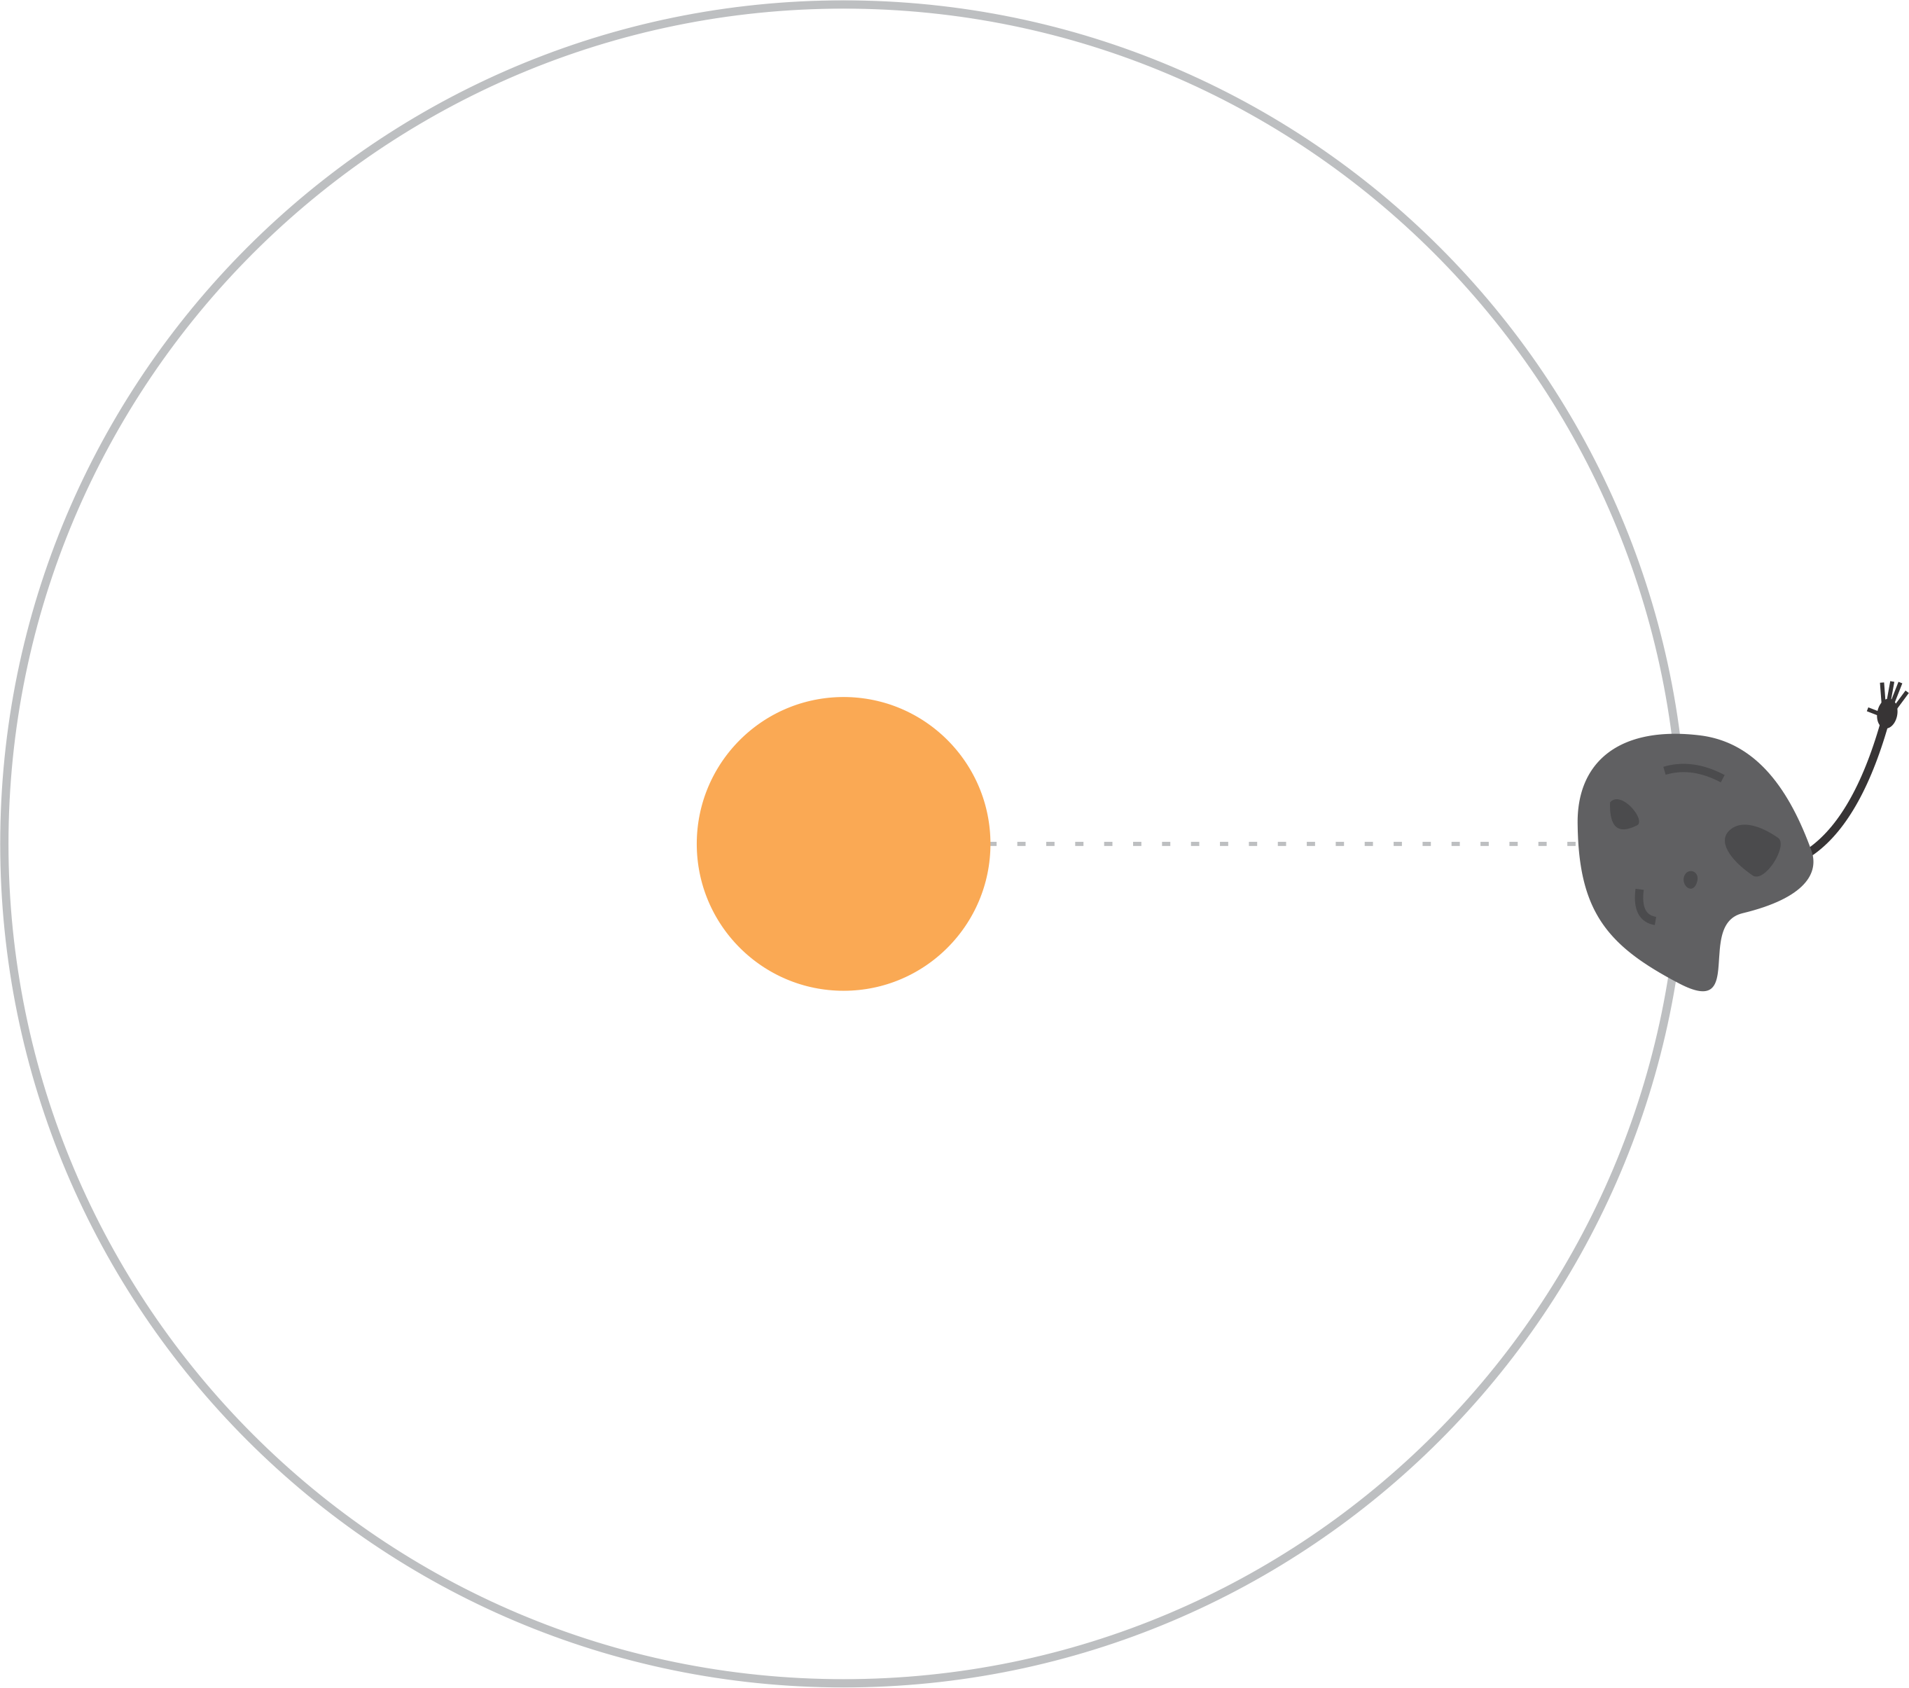
Relevant Physics
Hi guys!
It’s Tim.
Notes:
These are two effects of the same physical phenomenon. When the asteroid is heated by the sun, some of the photons are scattered, while others are absorbed and later re-radiated. This results in two forces: a torque that affects the asteroid’s rotation rate (YORP), and a radially outward thrust that affects the asteroid’s orbit (Yarkovsky).
The forces are very small; they affect asteroids smaller than ~40km in diameter on timescales of millions to billions of years

Slide 5
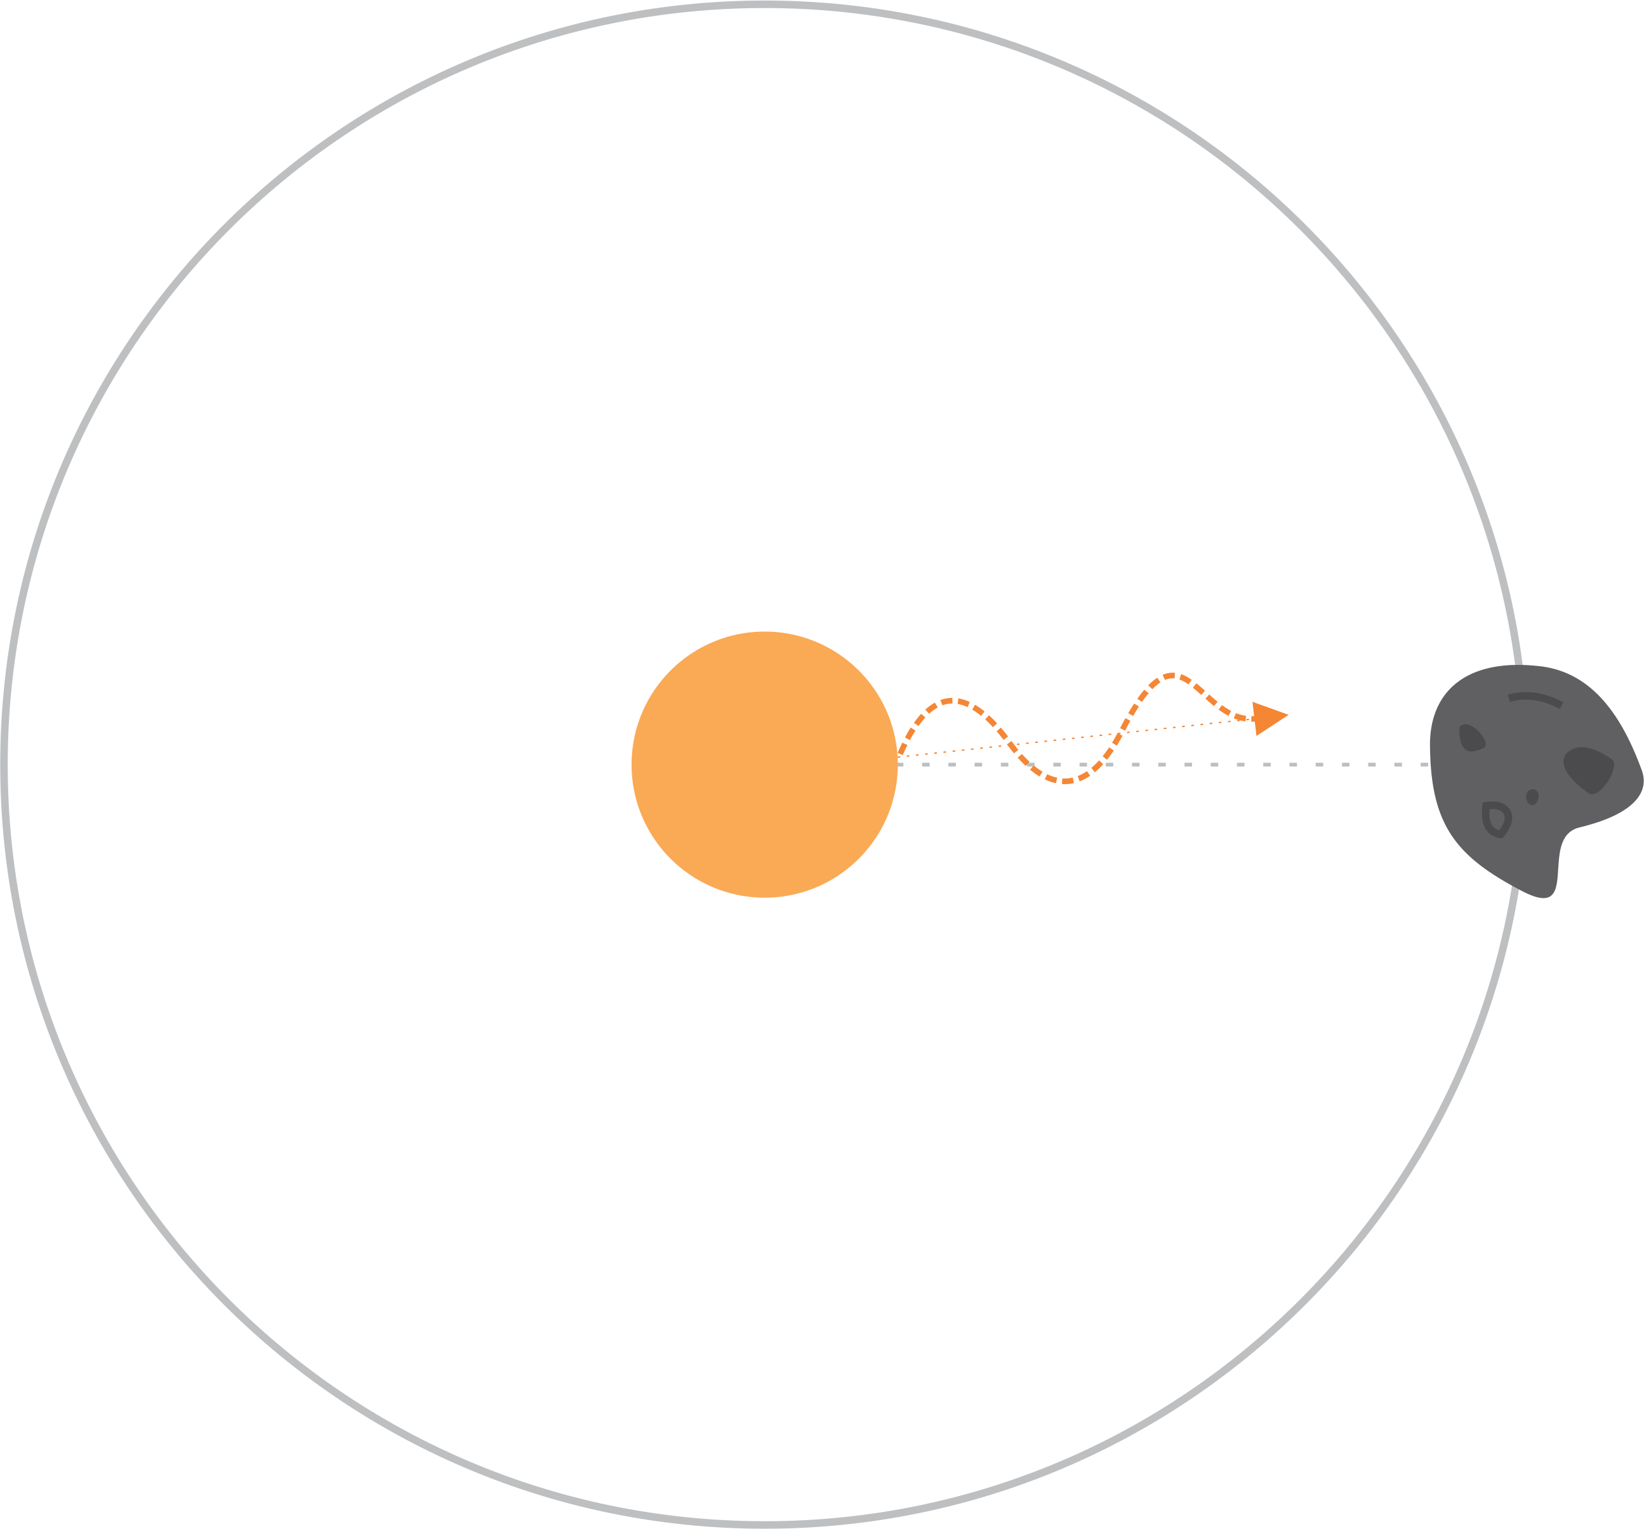
Relevant Physics

Slide 6
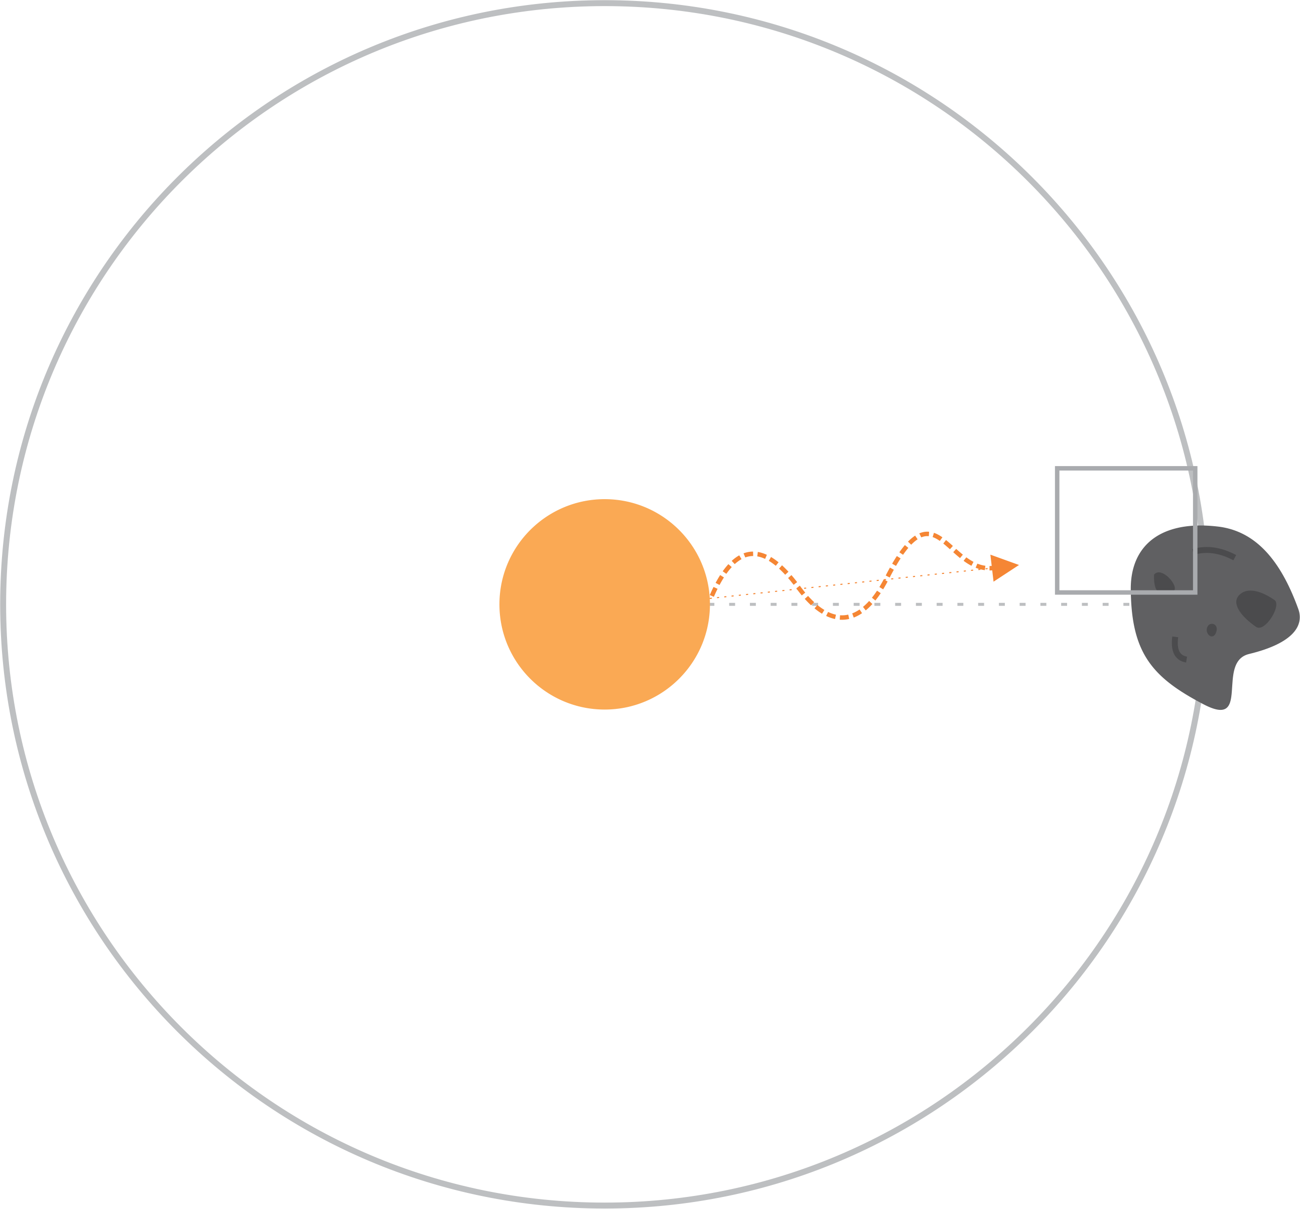
Relevant Physics

Slide 7
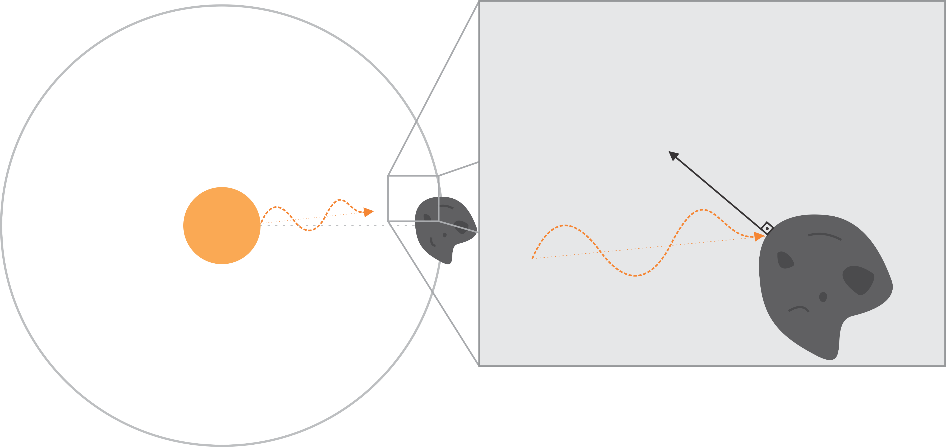
Relevant Physics
If photon is reflected: YORP (Yarkovsky-O'Keefe-Radzievskii-Paddack) effect.

Slide 8
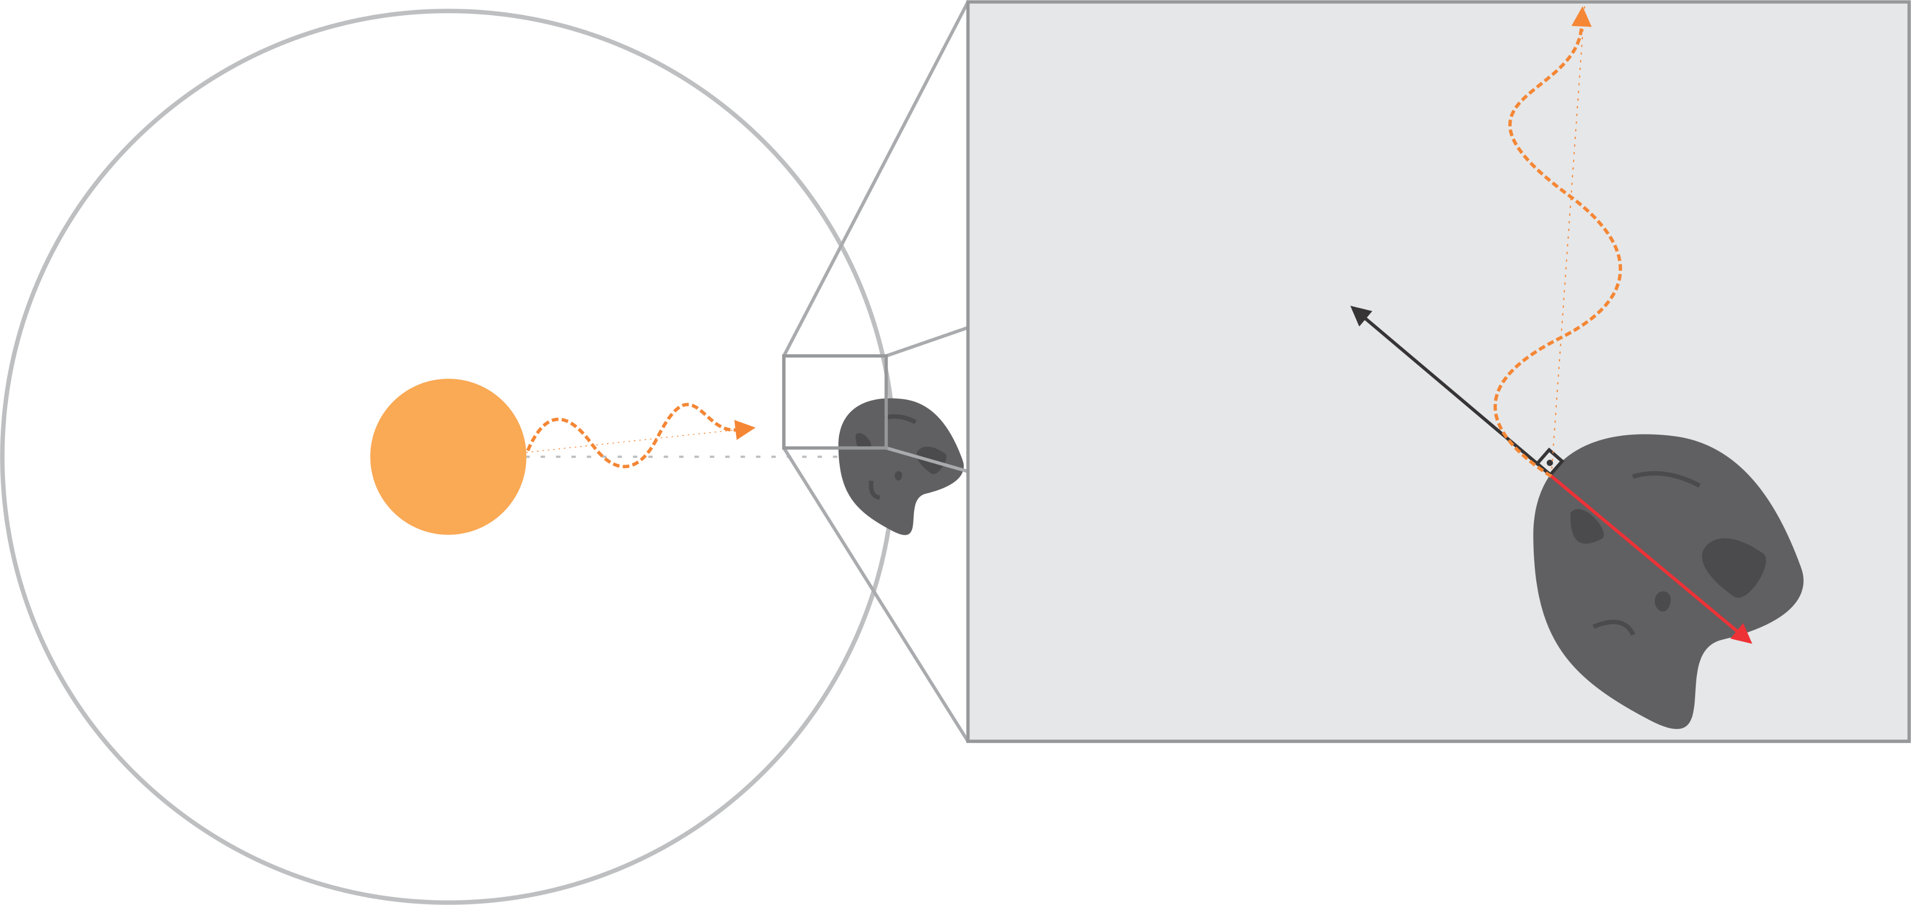
Relevant Physics
If photon is reflected: YORP (Yarkovsky-O'Keefe-Radzievskii-Paddack) effect.

Slide 9
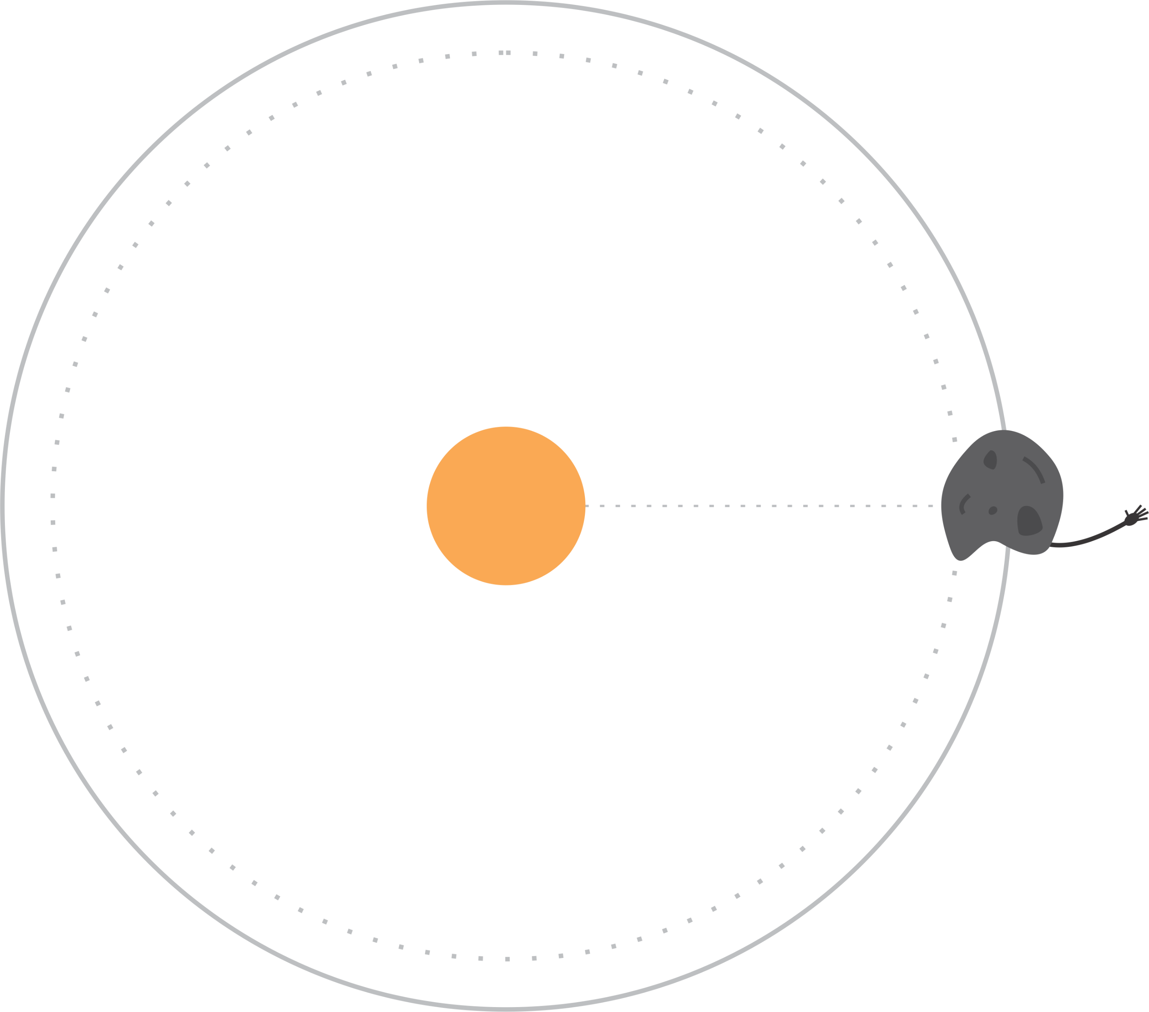
Relevant Physics
Oh no! He’s running away!
Let’s reel him back in and look at the second possibility.
Weee!

Slide 10
Relevant Physics

Slide 11
Relevant Physics

Slide 12
Relevant Physics
If photon is absorbed and re-emitted: Yarkovsky effect.

Slide 13
Relevant Physics
If photon is absorbed and re-emitted: Yarkovsky effect.

Slide 14
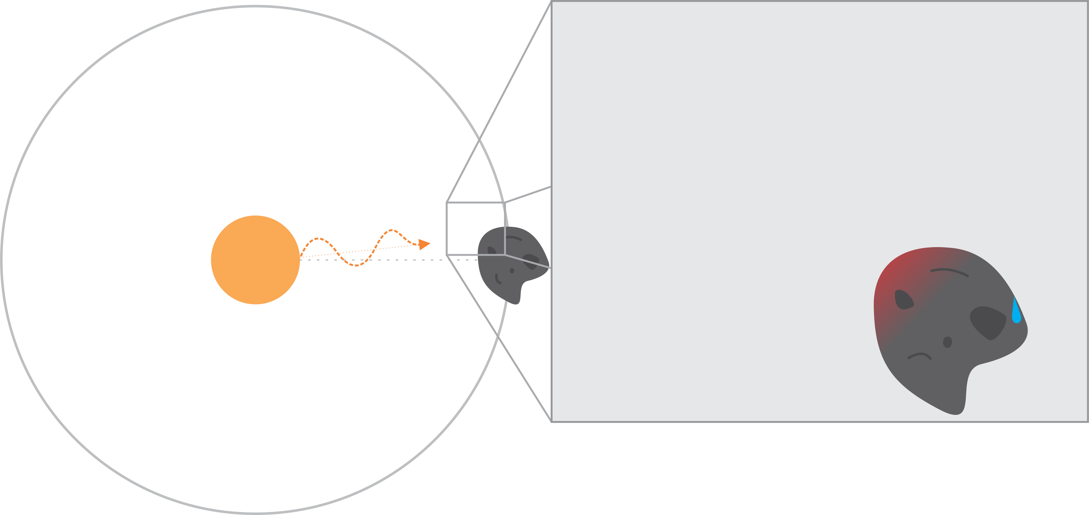
Relevant Physics
If photon is absorbed and re-emitted: Yarkovsky effect.

Slide 15
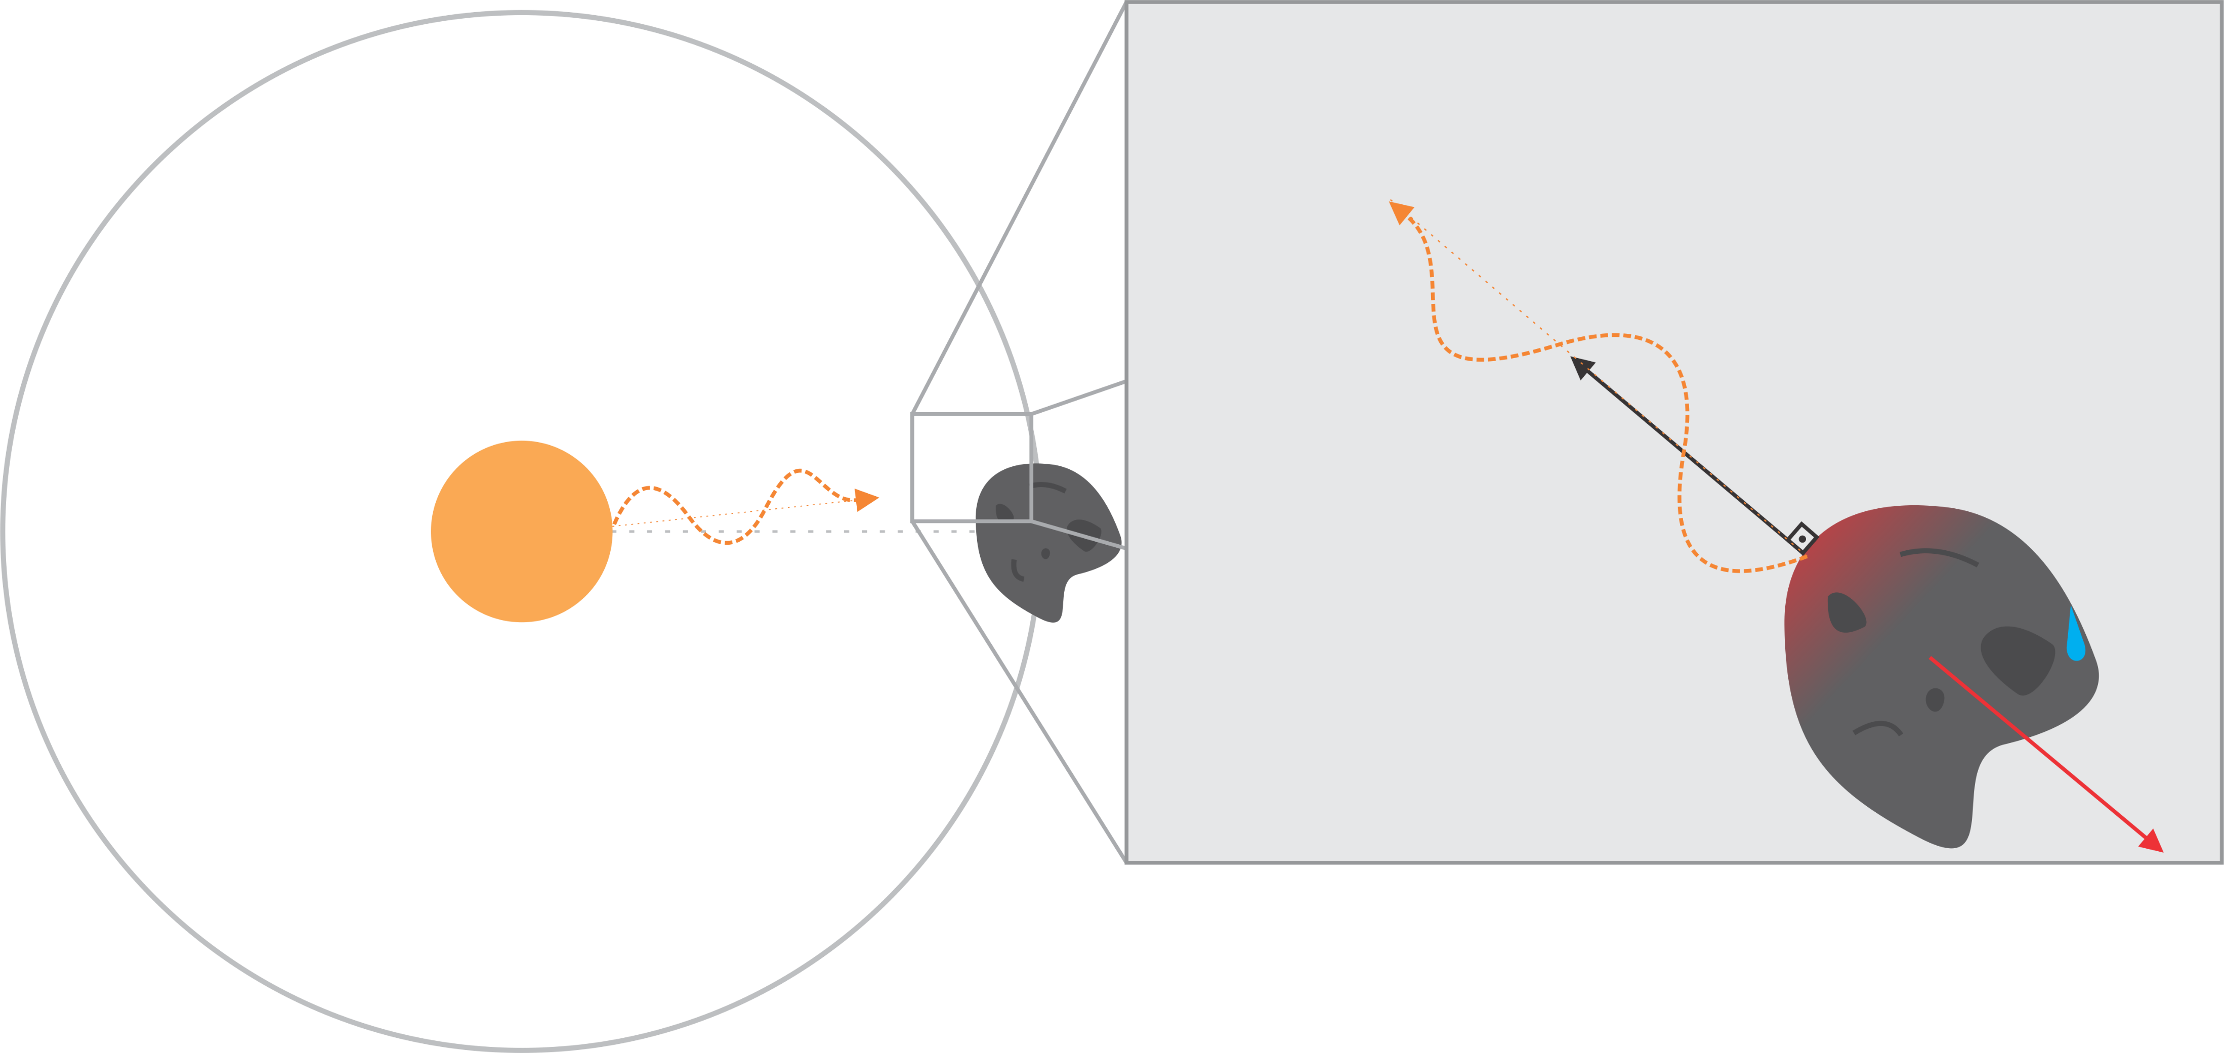
Relevant Physics
If photon is absorbed and re-emitted: Yarkovsky effect.

Slide 16
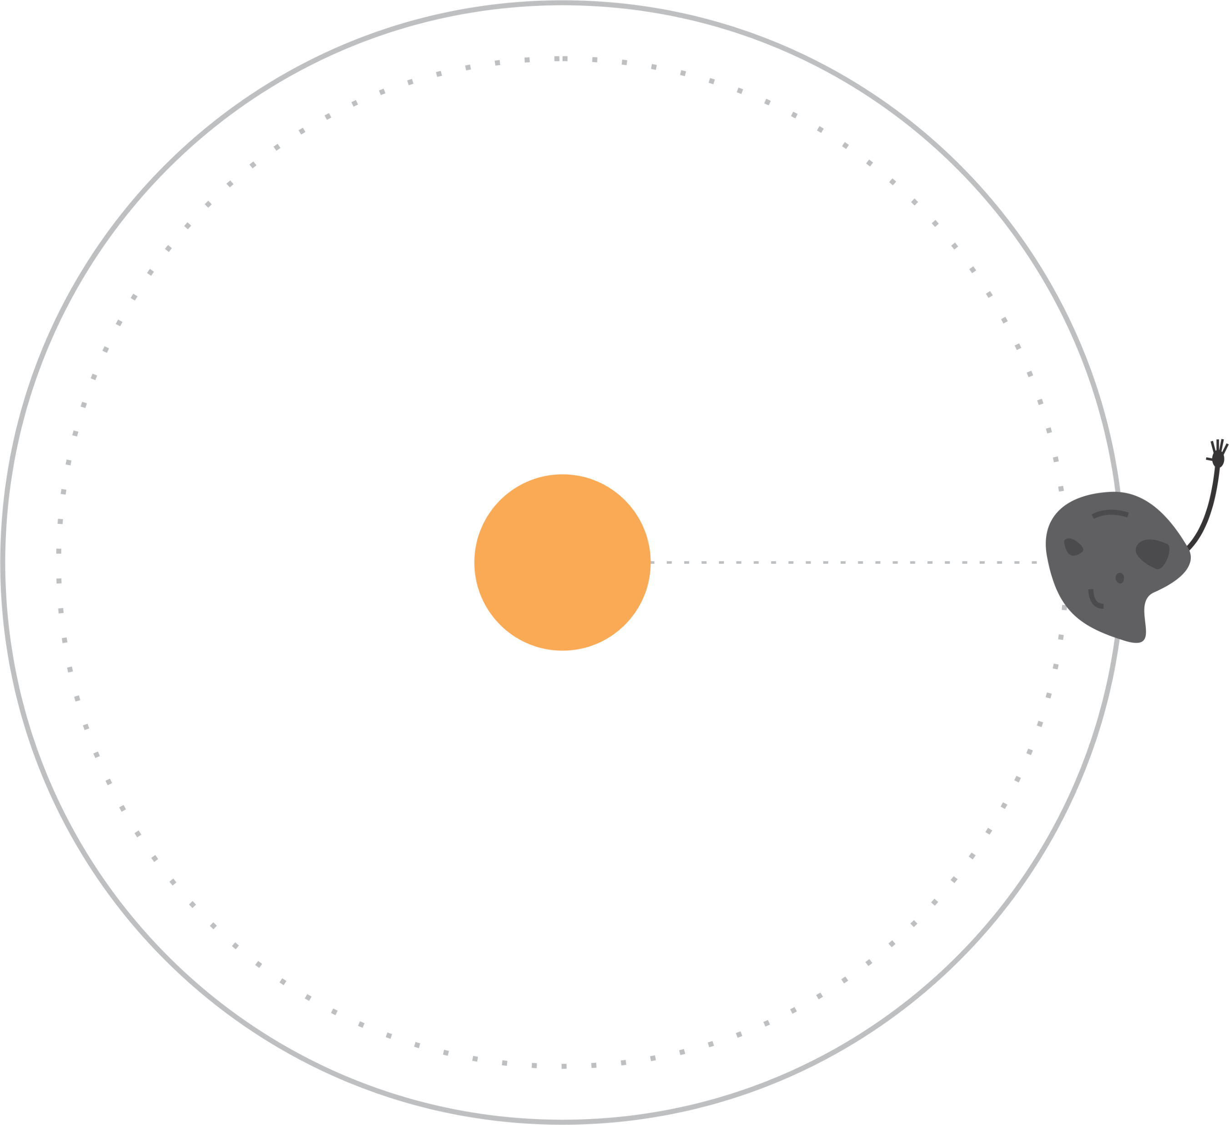
Relevant Physics
Ahh here he goes again…

Slide 17
Relevant Physics
Reflection: YORP Effect
Re-emission: Yarkovsky Effect

Slide 18
Presentation Overview
Relevant Physics
Scientific Justification
Project Overview
AMUSE Overview
Interesting Results

Slide 19
Scientific Justification
Accurately trace asteroid orbits and shapes in the event that they need to be landed on or destroyed
Simulate light curves from any observation point
Track the evolution of asteroids, i.e. when they will experience mass loss, shedding, or be broken up
Generalizable: multiple asteroids, non-solar systems, non-asteroid objects
[Note: currently only generalizable for convex asteroid shapes]
Notes:
In order to accurately target an asteroid, we must be aware of all the forces affecting it: this is important for projects such as DART
Also allows us to anticipate where asteroids are going/possible collisions/implications for Earth
Simulated light curves can be compared to real observations to detect anomalies
The simulation can later be generalized to systems other than the solar system
Can also be generalized for objects other than asteroids (satellites or planetary remnants)
AMUSE does not have implementation to simulate these effects: we were doing something new and interesting, and bridging forces which are not normally combined

Slide 20
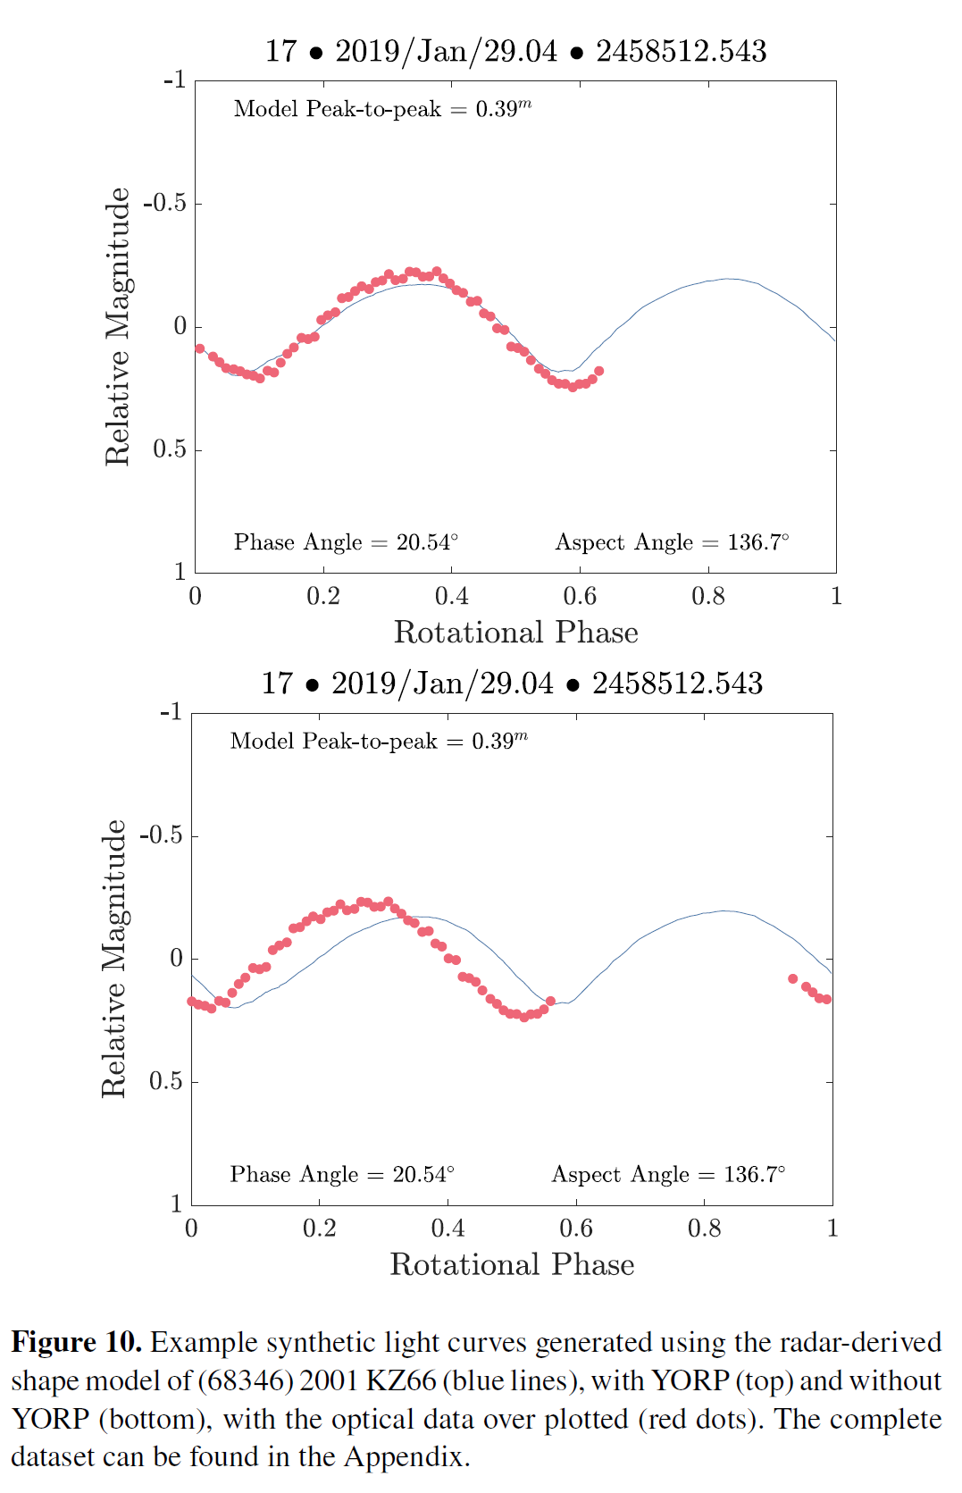
Scientific Justification
(Zegmott et al., 2021), Synthetic light curves generated with radar-based shape model of (68346) 2001 KZ66 (blue), w/out YORP (left) and with (right). Optical data plotted (red dots).

Slide 21
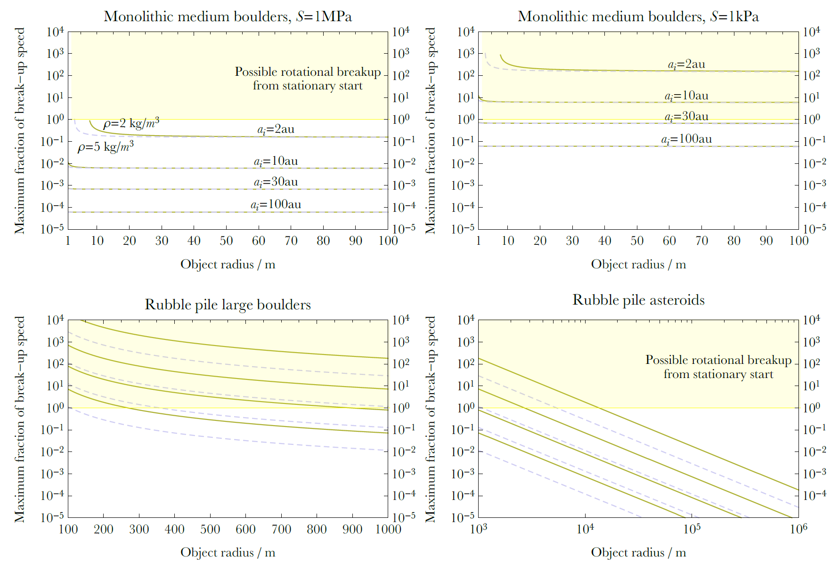
(Veras et al., 2021), Maximum fraction of break up speed achieved due to the YORP effect.
Value > 1 indicates a possibility of break-up due to radiation rotation.

Slide 22
Presentation Overview
Relevant Physics
Scientific Justification
Project Overview
AMUSE Overview
Interesting Results

Slide 23
Project Overview
Intention:
Implement the YORP (Yarkovsky-O'Keefe-Radzievskii-Paddack) and Yarkovsky effects into AMUSE in order to accurately simulate asteroid orbits in our solar system
Be able to return asteroid light curves from various points in space
Code:
Asteroid and solar system initialization
Functionality for different asteroid shapes
Field code
Gravity solver and n-body
Bridge between n-body and radiation

Slide 24
Presentation Overview
Relevant Physics
Scientific Justification
Project Overview
AMUSE Overview
Interesting Results

Slide 25
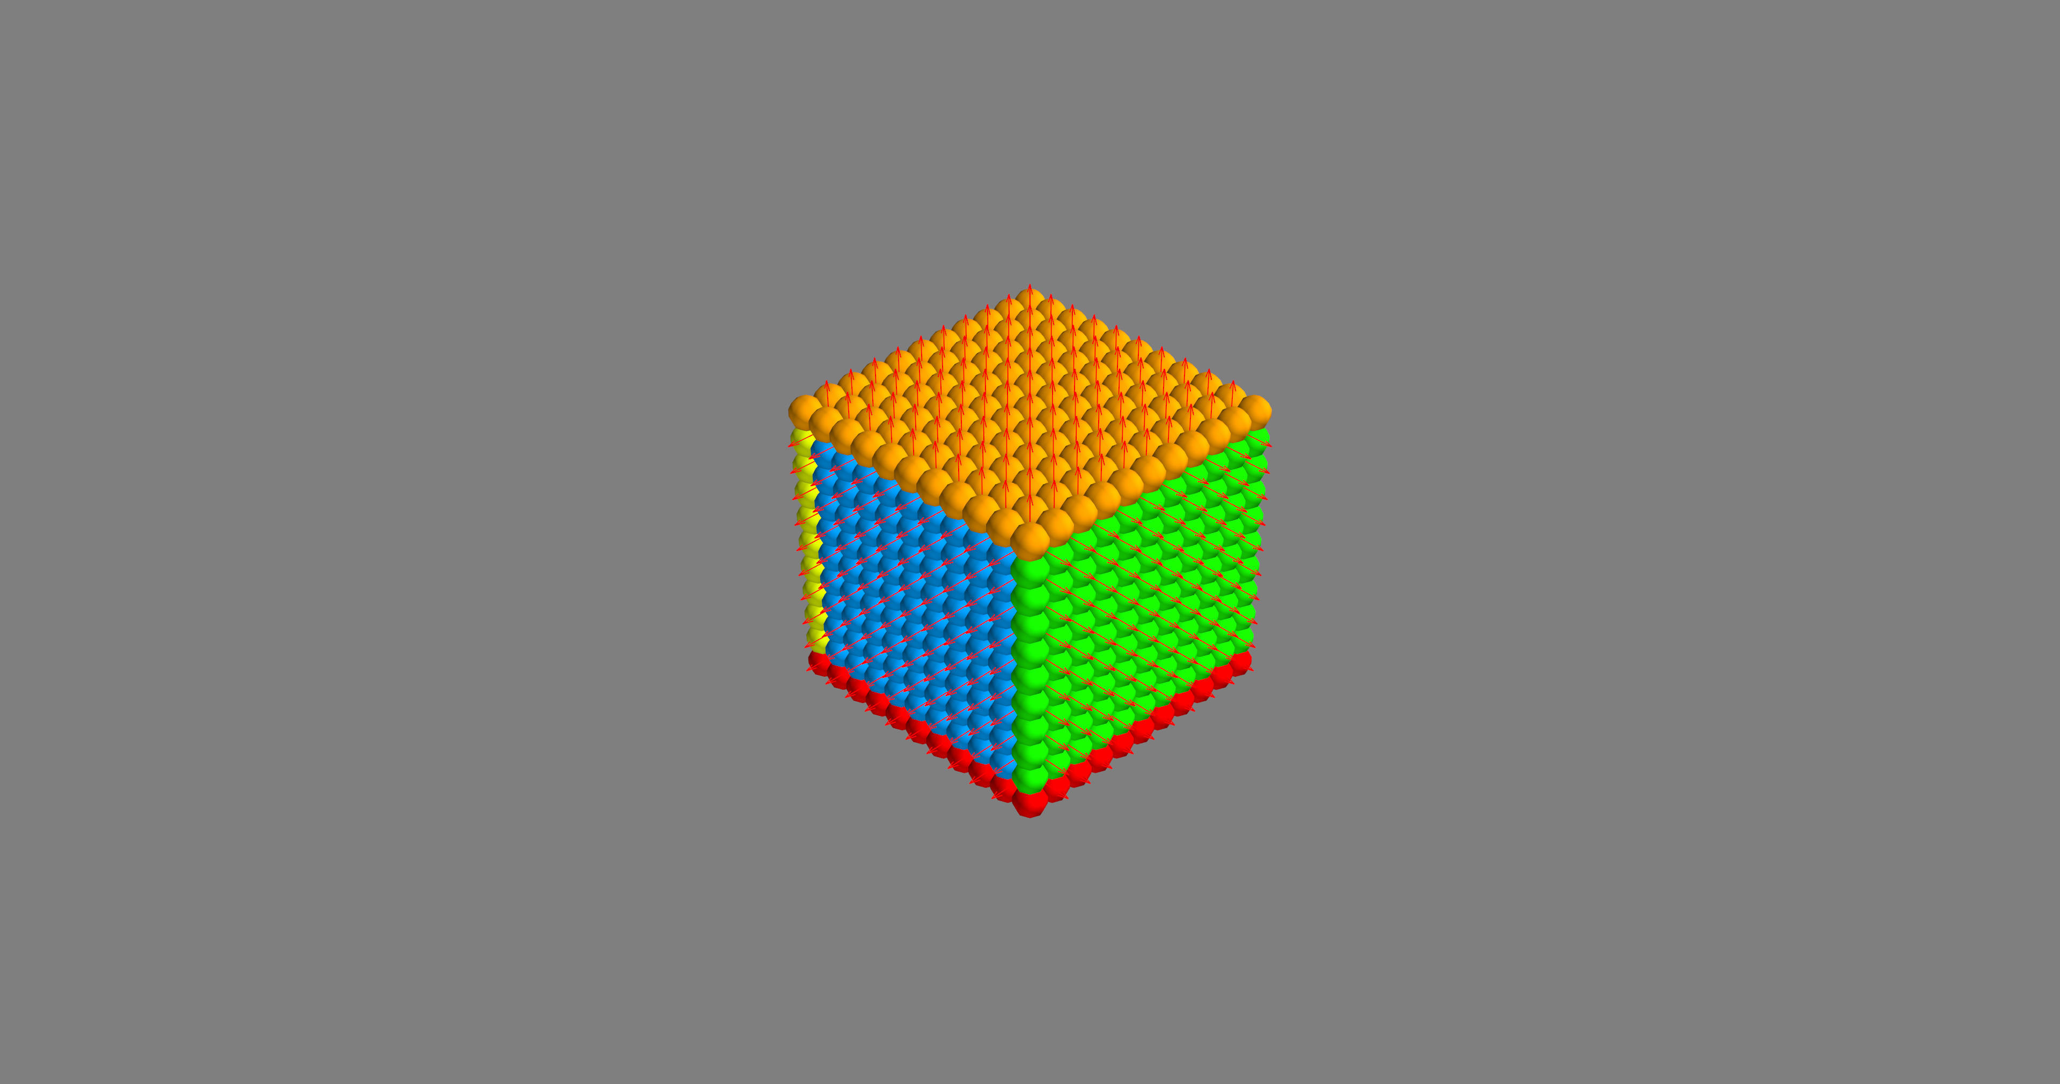
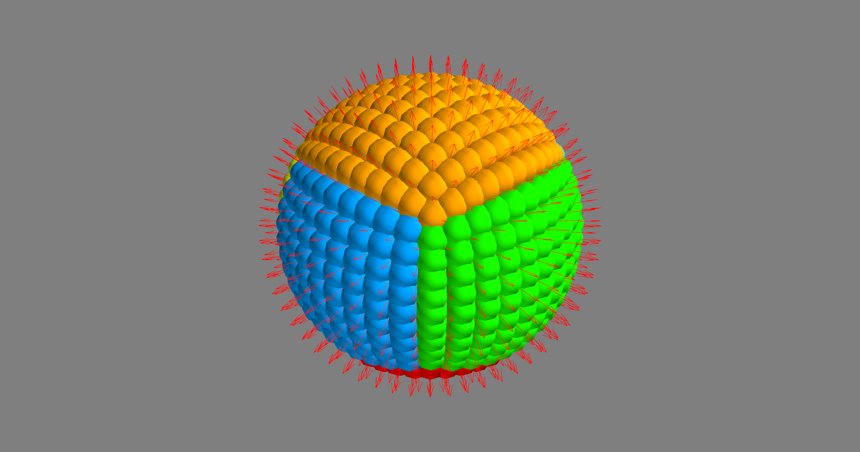
AMUSE Overview: Basics
How to get tessellated asteroid surfaces?
MATH!
cube2sphere
Notes:
Used a program that would create patches of equal size on a cube, then morph that cube into a sphere with the same radius
Normal vectors found from the center of each patch by conserving the normal vectors from the cube, or failing that, by assuming patch flatness
We needed these normal vectors to calculate flux directions (we will talk more about this in the field code section)
[There is some overlap at the edges of the sphere: how is this accounted for?]
This configuration is generalizable to weirdly-shaped asteroids

Slide 26
AMUSE Overview: Building block
Asteroid (Custom amuse.Particle subclass)
Hold tessellated surfaces
[positional info (area, normal), physical info (albedo, emissivity etc.)]
Calculate YORPkovsky acceleration
[called by the system class, basis for the custom field code]
Calculate flux
[called by the system class, returns the total flux over surfaces]
Notes:
Asteroids is a subclass of AMUSE Particle [Explain how this is different from AMUSE Particles and why we chose Particle]
get_albedo_emissivity either takes an array input for albedo and emissivity, or initializes random values
get_acceleration is where the field code is stored. Given the directions to the star and observer, it calculates the YORPkovsky forces on the asteroid patch by patch and returns accelerations using the math from a few slides ago. The directions are calculated in the System class.
YORP/Yarkovsky code created from scratch, specifically for this project
get_flux calculates the sum of the reflected flux and re-emitted flux
Reflection_reception: checks whether the observer can see the reflected flux from the asteroid
System is a subclass of AMUSE Particles that initializes input bodies into a solar system
get_directions calculates the directions, then calculate_flux plugs them into asteroid.get_flux. System stores that flux where it can be called by plotting code to create light curves.
get_gravity_at_point is the function called by the bridge to be able to evolve the system. It calculates accelerations on all inputs using asteroid.get_acceleration.

Slide 27
AMUSE Overview: Storage
System (Custom class)
Hold asteroids and stellar objects
[either Asteroid class or amuse.Particle class]
Calculate directions to star and observer
[necessary for acceleration and flux calculations]
Custom field code
[called by the bridge at every simulation time step, returns acceleration]
Notes:
Asteroids is a subclass of AMUSE Particle [Explain how this is different from AMUSE Particles and why we chose Particle]
get_albedo_emissivity either takes an array input for albedo and emissivity, or initializes random values
get_acceleration is where the field code is stored. Given the directions to the star and observer, it calculates the YORPkovsky forces on the asteroid patch by patch and returns accelerations using the math from a few slides ago. The directions are calculated in the System class.
YORP/Yarkovsky code created from scratch, specifically for this project
get_flux calculates the sum of the reflected flux and re-emitted flux
Reflection_reception: checks whether the observer can see the reflected flux from the asteroid
System is a subclass of AMUSE Particles that initializes input bodies into a solar system
get_directions calculates the directions, then calculate_flux plugs them into asteroid.get_flux. System stores that flux where it can be called by plotting code to create light curves.
get_gravity_at_point is the function called by the bridge to be able to evolve the system. It calculates accelerations on all inputs using asteroid.get_acceleration.

Slide 28
AMUSE Overview: Simulation
YORPkovsky (Field Code)
Solar System (Hermite N-body)
Asteroids (Hermite N-body)
Evolve (Custom function)
Solar system: Hermite n-body
Asteroids: Hermite n-body
Asteroids perturbed by field code and Solar system
#Assemble the bridge.
bridgey_bridge = bridge.Bridge() bridgey_bridge.add_system(ss_gravity_code, ())
bridgey_bridge.add_system(ast_gravity_code, (ss_gravity_code, system))
Notes:
Our solar system: Sun, Earth, Jupiter
- This is a hierarchical bridge because we have multiple systems talking to Asteroids
- Note that we do NOT have the asteroids talk back to the solar system; its effects on the SS bodies are negligible
- [Why did we use Hermite vs ph4? Something about tree codes]
- ast_gravity_code perturbed by both ss_gravity_code and system: system contains get_gravity_at_point, which calls the field code from the Asteroid class.

Slide 29
Presentation Overview
Relevant Physics
Scientific Justification
Project Overview
AMUSE Overview
Interesting Results

Slide 30
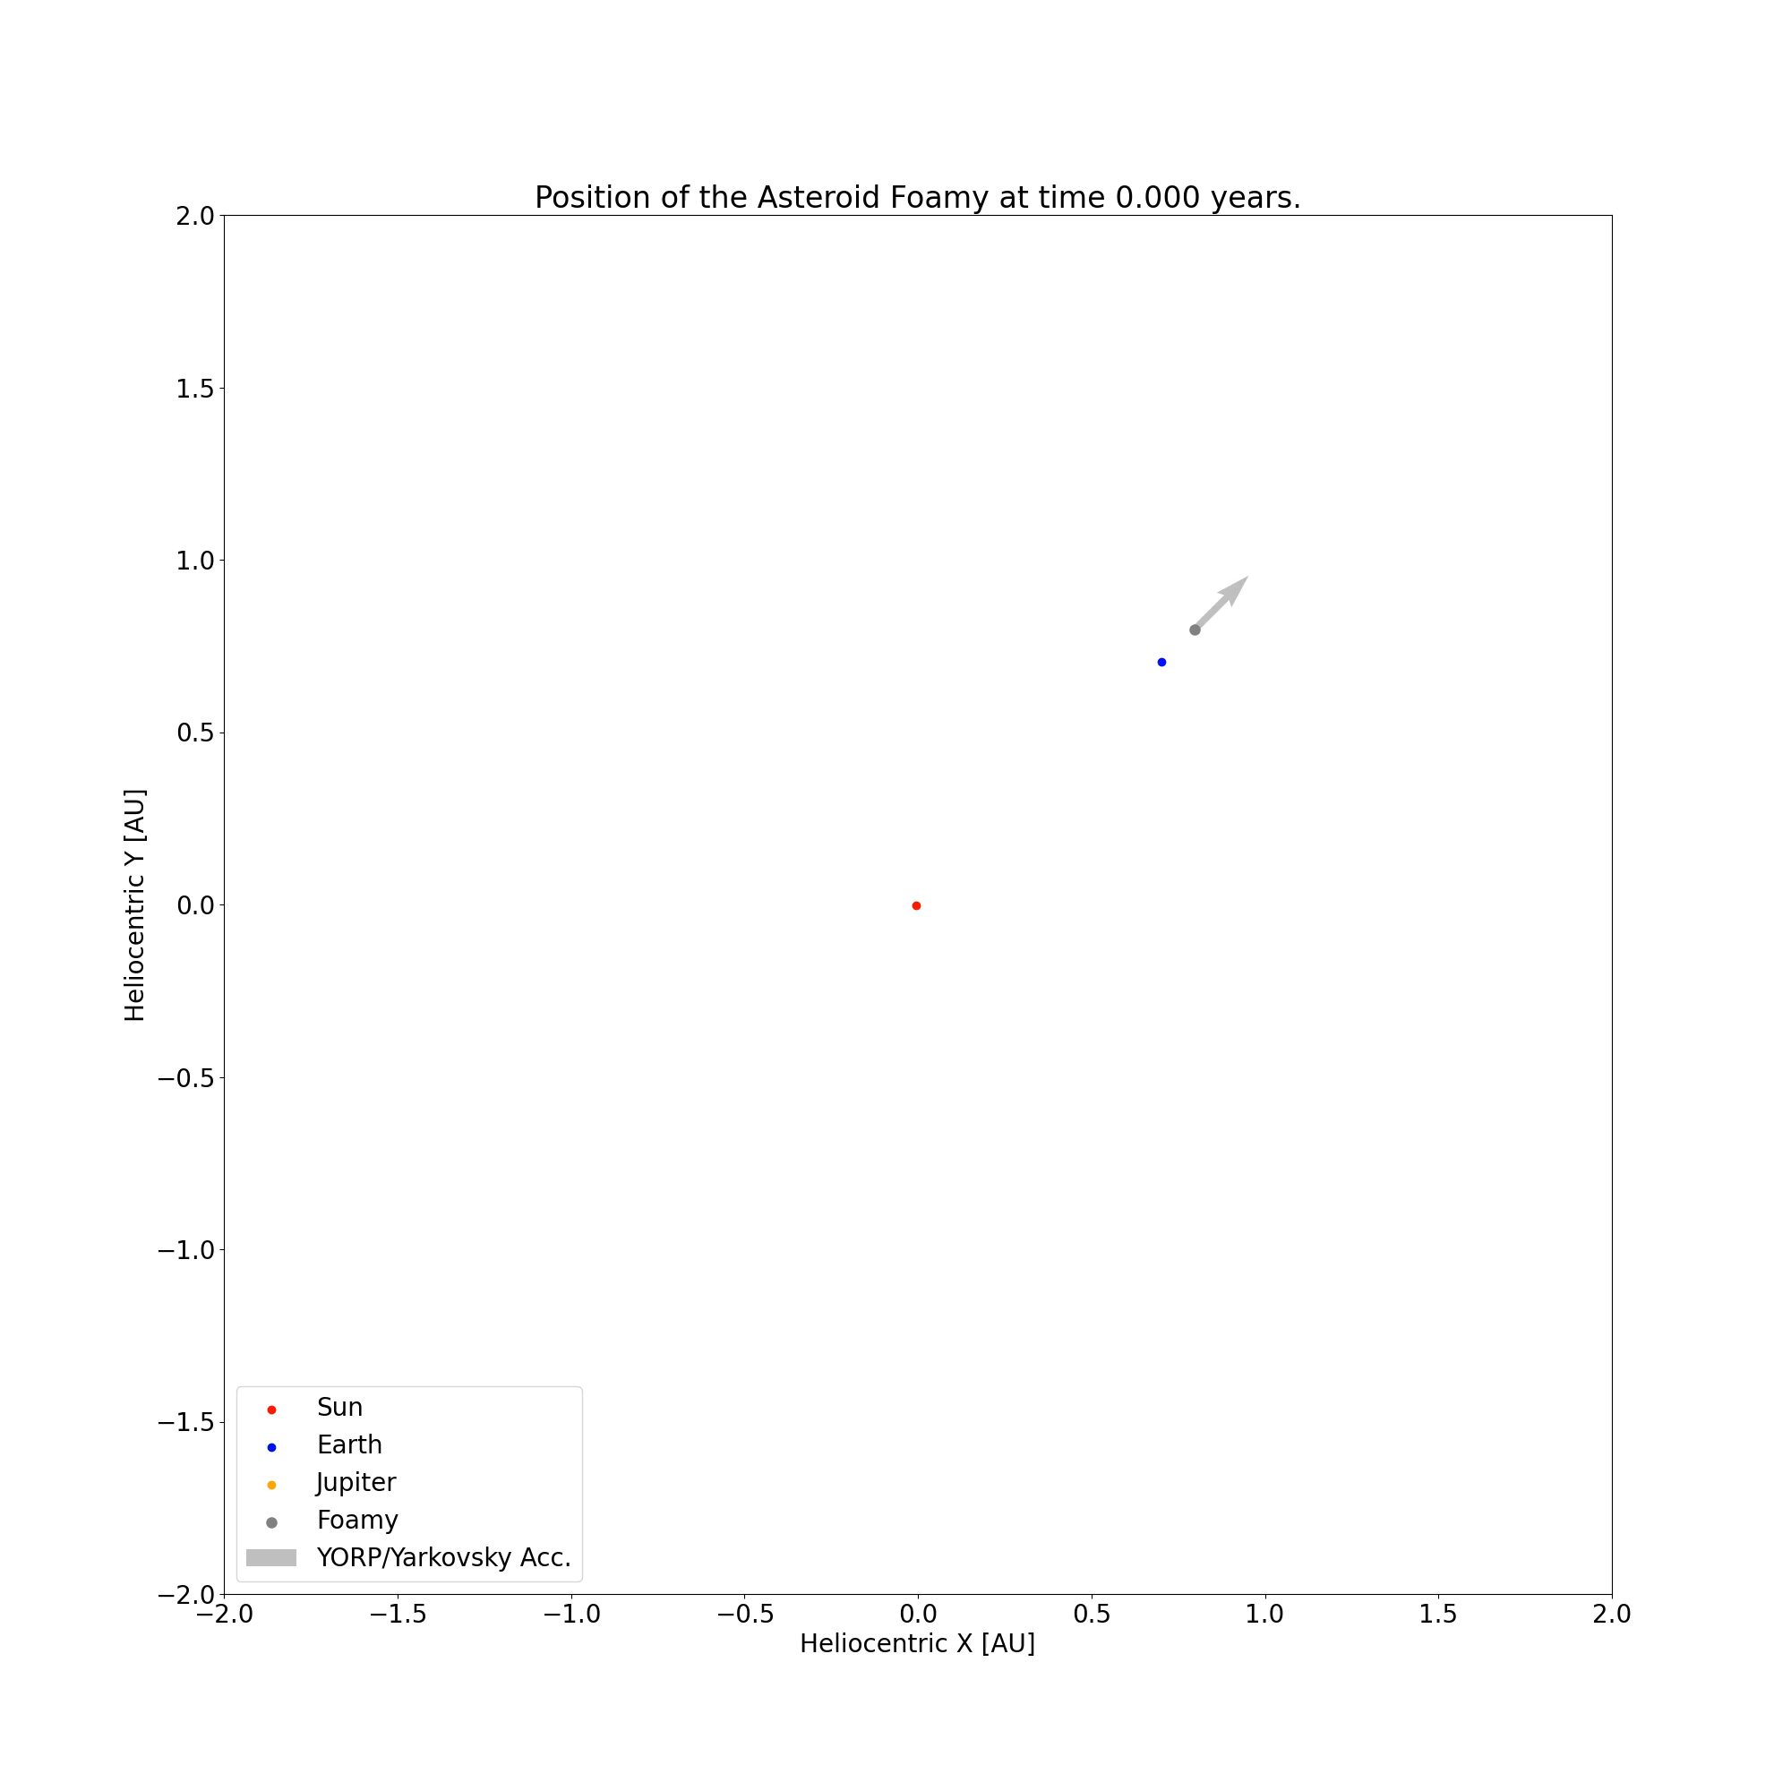
Interesting Results
Foamy:
Low density, large radius
470kg, 0.3km
Exaggerated to show effect

Slide 31
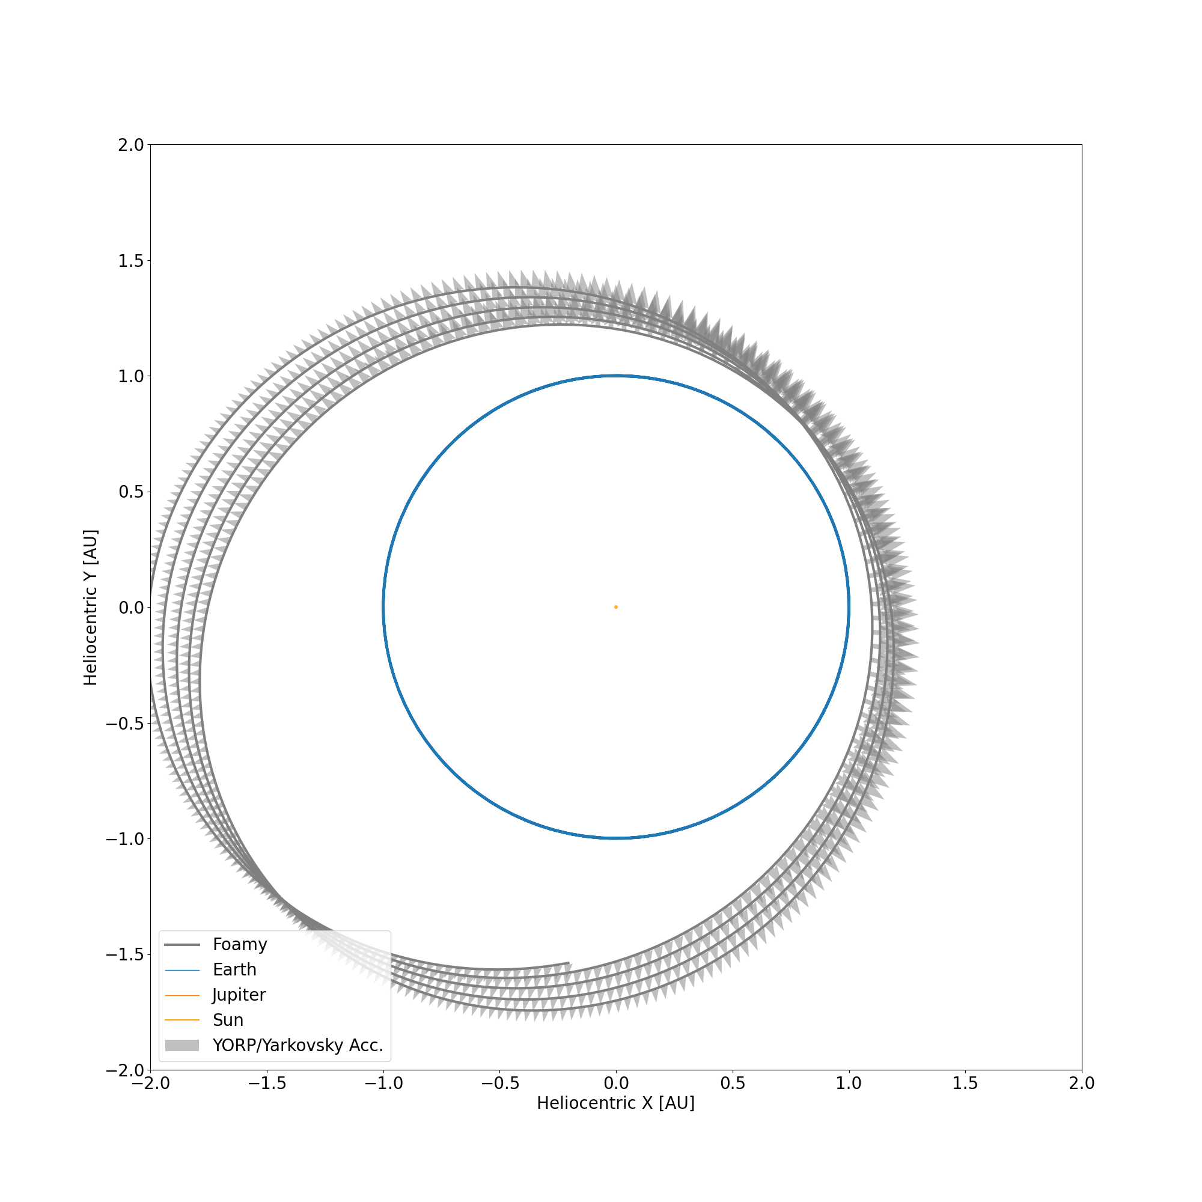
Interesting Results
Foamy:
Low density, large radius
470kg, 0.3km
Exaggerated to show effect

Slide 32
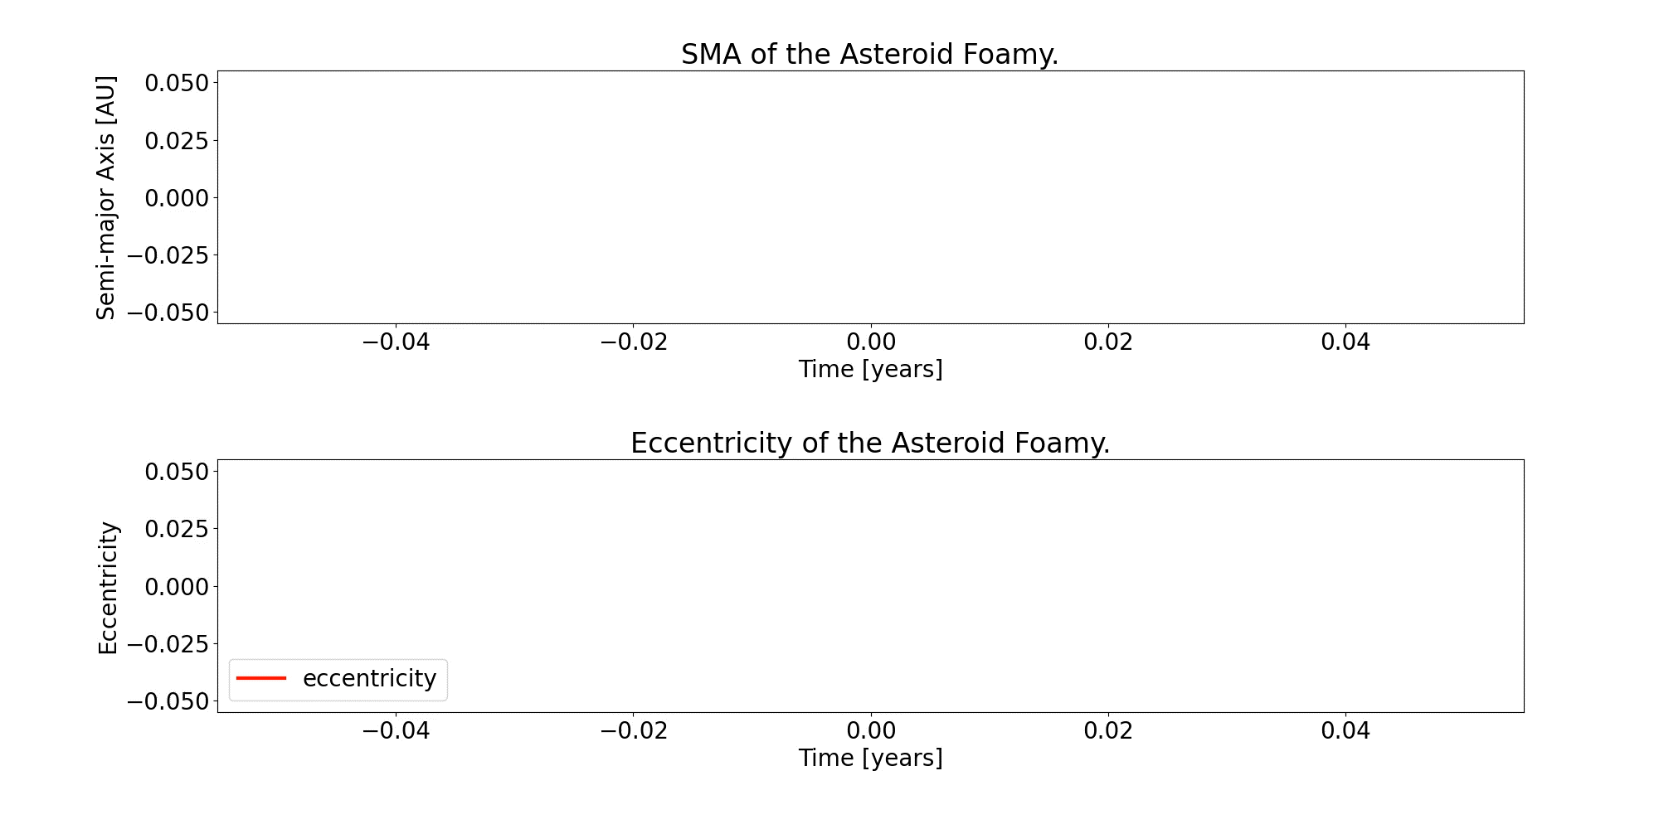
Interesting Results

Slide 33
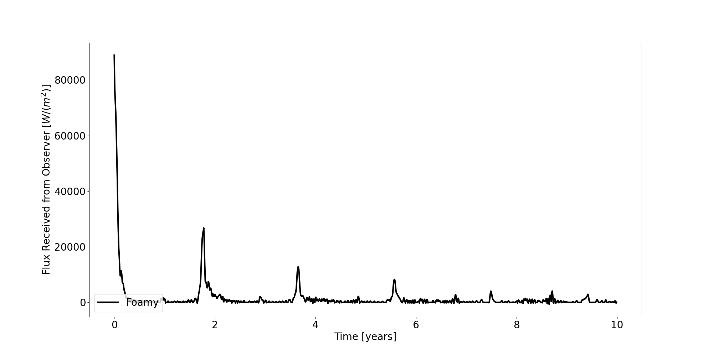
Interesting Results?

Slide 34
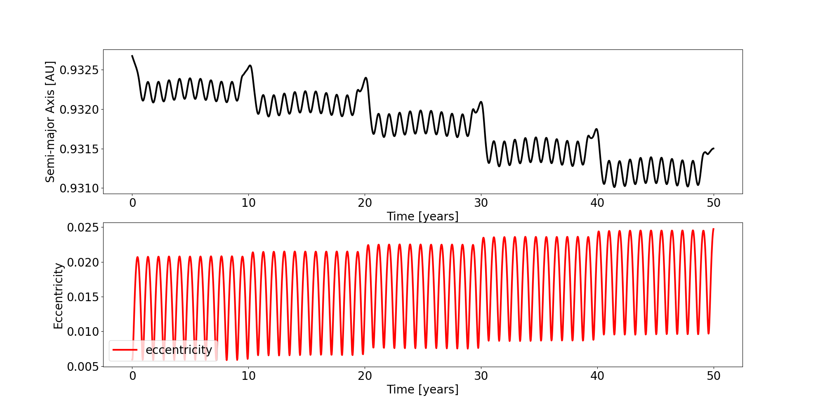
Interesting Results???
Apophis: $6.1×{10}^{10}$kg, 0.34km
These are not the same plot, but well, they kind of are…

Slide 35
Extra Ideas
Smooth temperature function
Multiple asteroids
Observationally accurate albedo
Non-solar system (multiple stars, different planets/resonances, etc.)
Non-asteroid objects
Taking eccentricity and inclination into account
The list goes on…
Notes:
- Explain how in the flux plot we can see that the temperature function is piecewise rather than smooth (if we don’t manage to implement this before Wednesday)
- We can take eccentricity and inclination into account by making sure all binaries are created, i.e. initializing the system with make_binary_from_orbital_elements

Slide 36


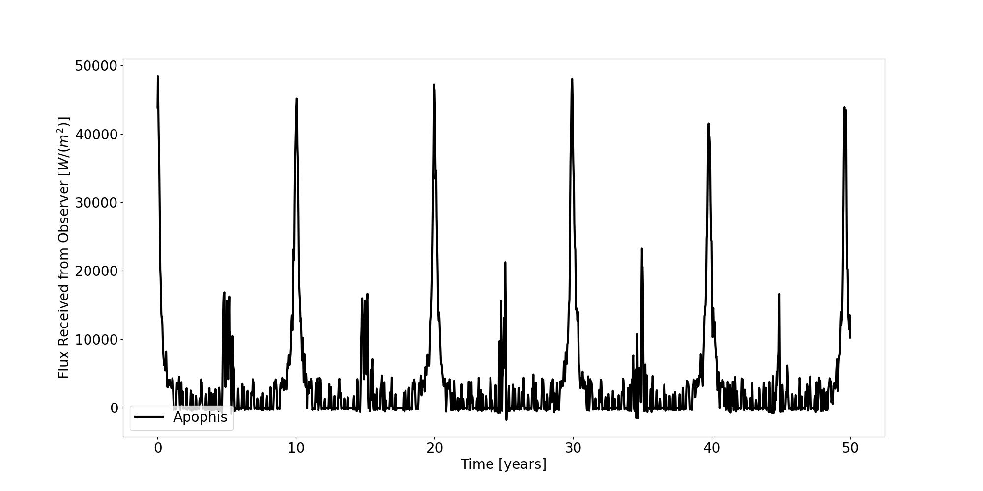
Summary
YORP and Yarkovsky effects
Easy to demonstrate with light pseudo-asteroids
Effect not noticeable in short timescales for realistic cases…
Flux is confusing, ray-tracing is costly

Slide 38
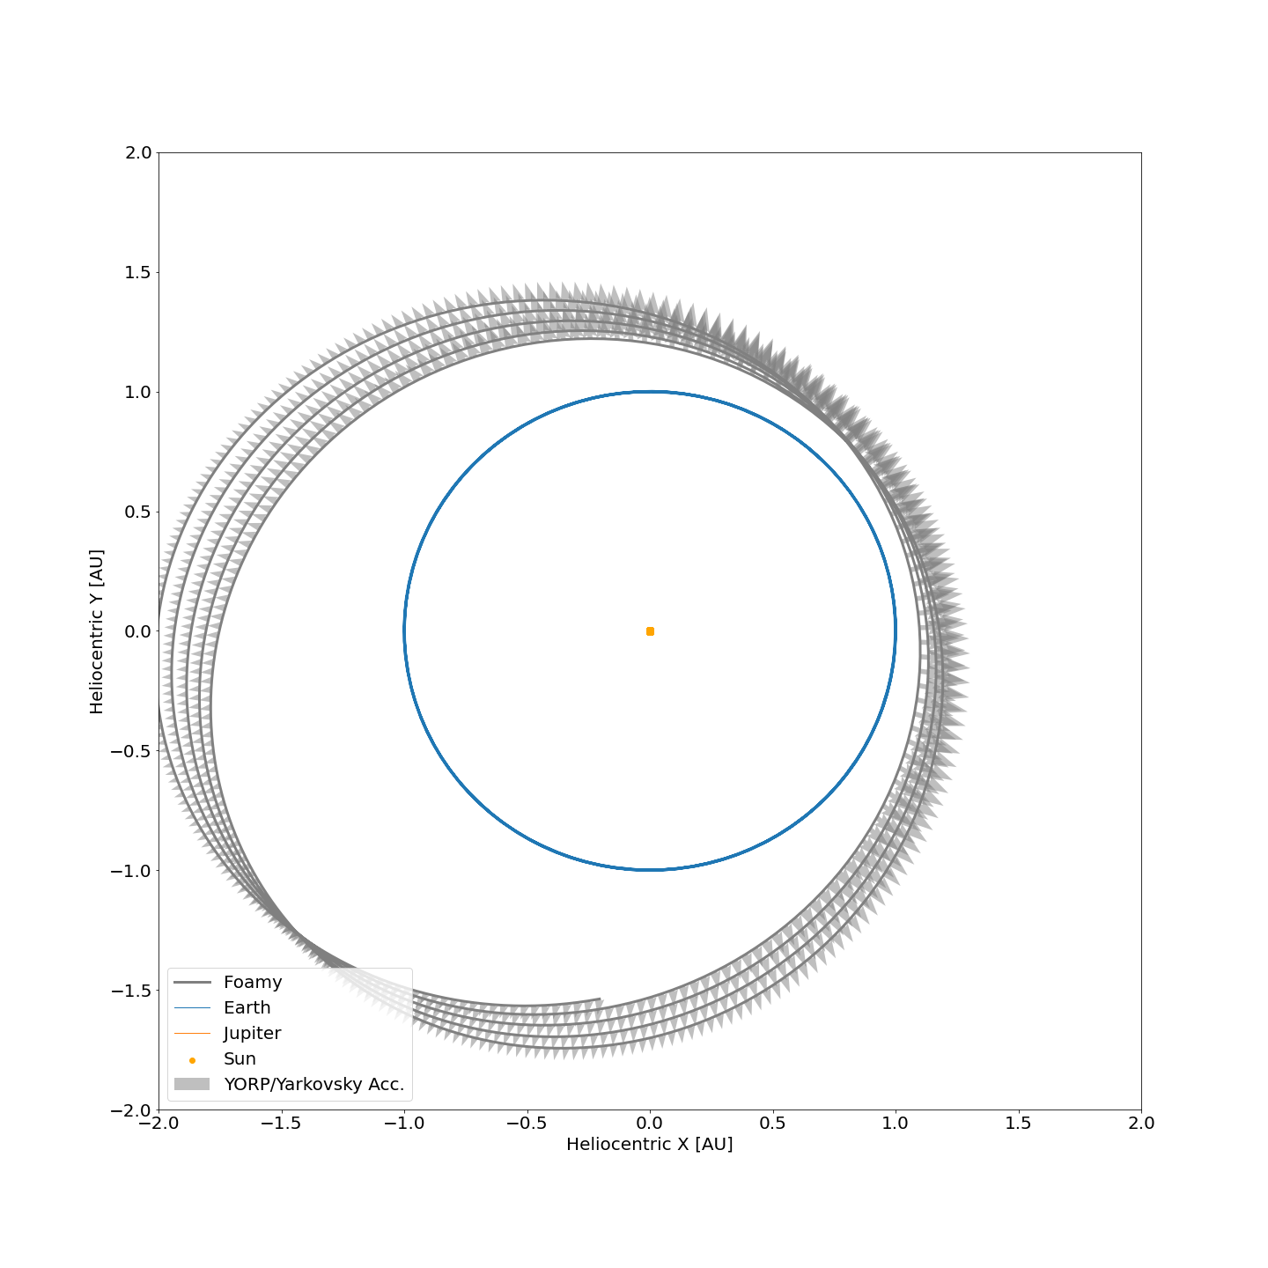
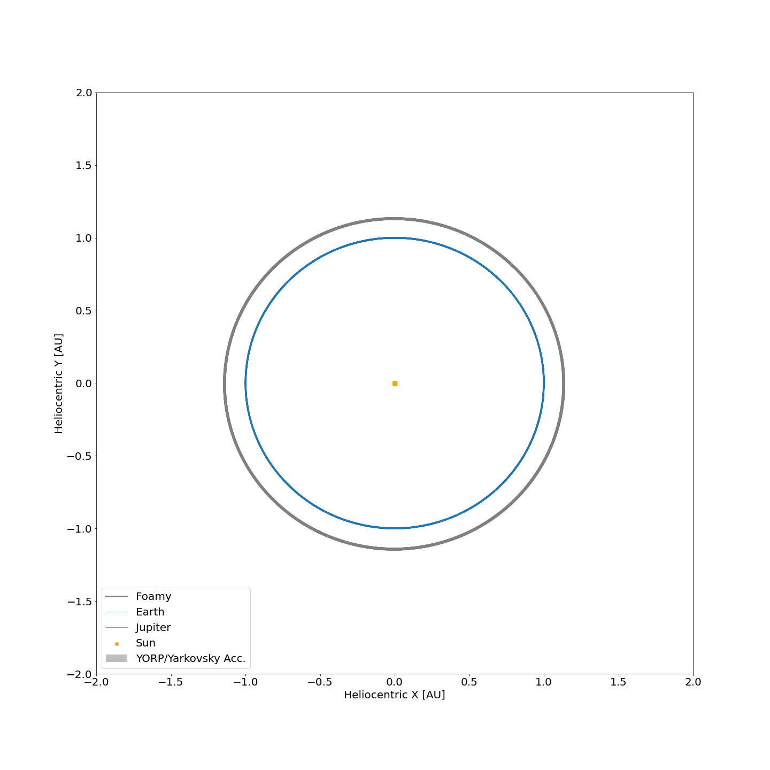

Slide 39
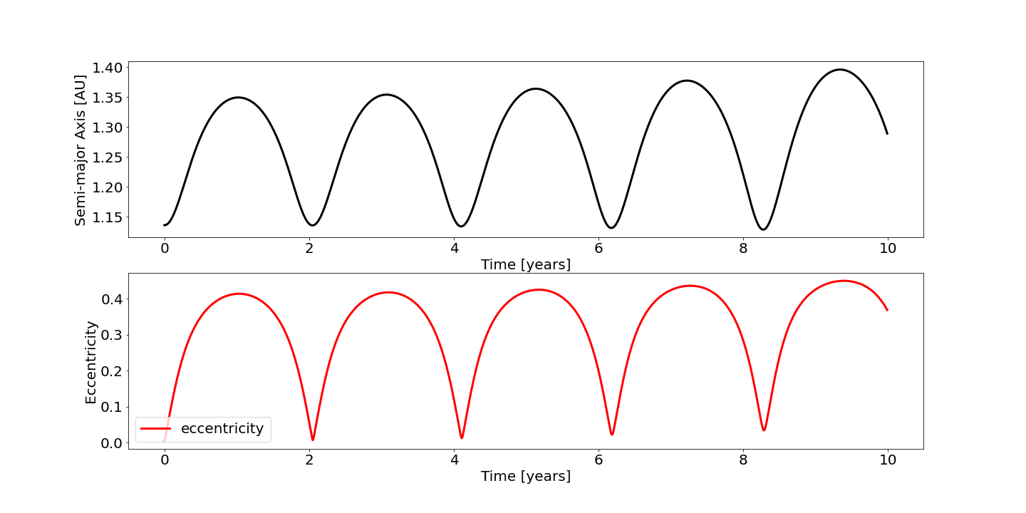
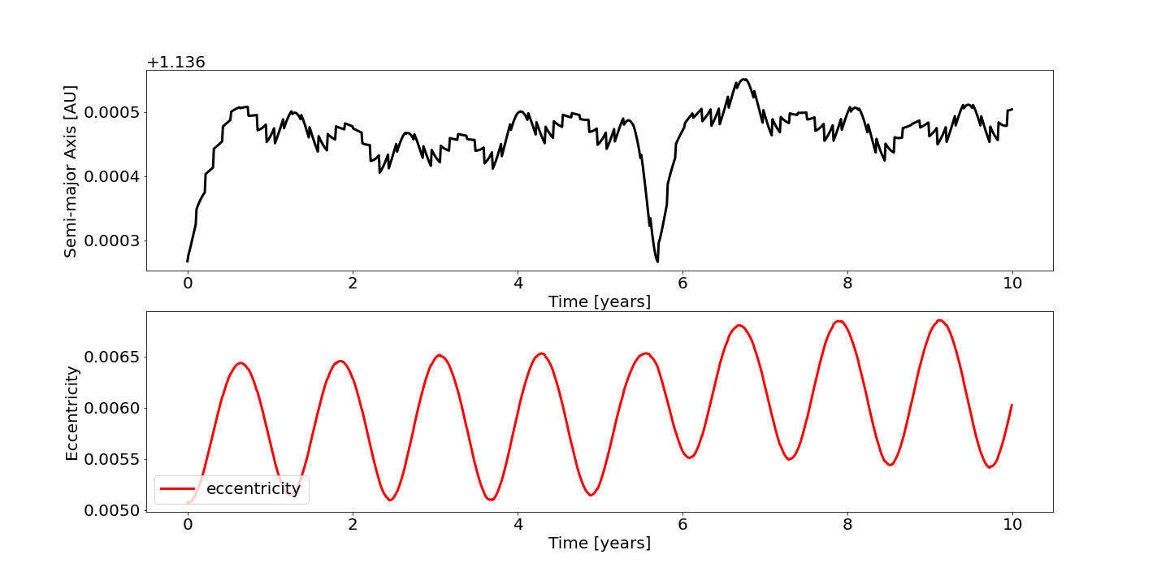
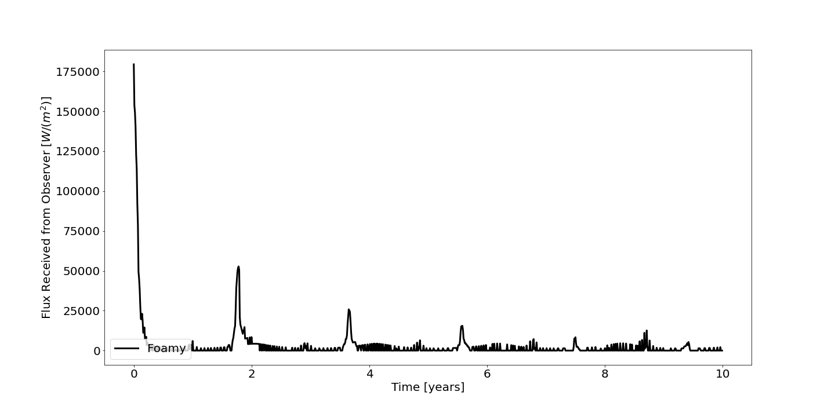
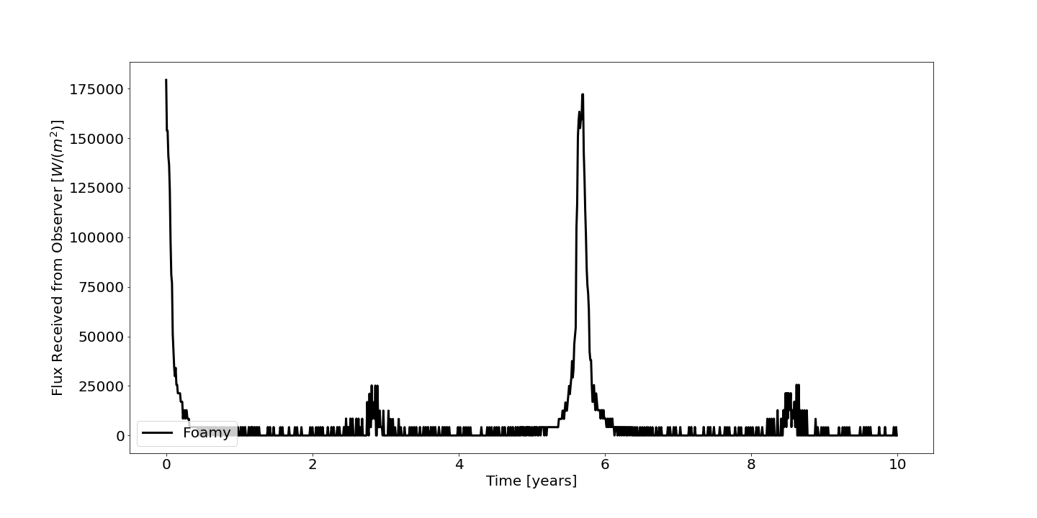

Slide 40



Relevant Physics –Add. 1: Equations
$d{\text{f}}_{sca}=−\frac{F}{c}\left(K_{1}^{sca}{\text{n}}_{⊥}+K_{2}^{sca}\text{m}\right)dS$
$d{\text{f}}_{th}=−\frac{σT^{4}}{c}(K_{1}^{th}{\text{n}}_{⊥}+K_{2}^{th}\text{m})dS$
After approximation:
$d{\text{f}}_{sca}=−\frac{2}{3}\frac{μ_{0}AF}{c}{\text{n}}_{⊥}dS$
$d{\text{f}}_{th}=−\frac{2}{3}\frac{εσT^{4}}{c}{\text{n}}_{⊥}dS$
Temperature cannot be assumed to be constant, but using conservation of energy and the Lambert and Rubincam approximations:
$εσT^{4}=\left(1−A\right)μ_{0}F$
$\text{m}= \frac{{\text{n}}_{0} −{{ μ}_{0}\text{n}}_{⊥}}{\sqrt{1 − μ_{0}^{2}}}$
$K_{1}^{sca}\left(μ_{0}\right)= \frac{2}{3}μ_{0}A$
$K_{1}^{th}\left(μ_{0}\right)= \frac{2}{3}ε$
$K_{2}^{sca}$ = ${ K}_{2}^{th}$ = 0
Notes:
These are two effects of the same physical phenomenon. When the asteroid is heated by the sun, some of the photons are scattered, while others are absorbed and later re-radiated. This results in two forces: a torque that affects the asteroid’s rotation rate (YORP), and a radially outward thrust that affects the asteroid’s orbit (Yarkovsky).
The forces are very small; they affect asteroids smaller than ~40km in diameter on timescales of millions to billions of years
We use the simplest solution with Lambert’s law
F = incident flux
$K_{i}^{sca}$ = surface scattering components
${\text{n}}_{⊥}$ = surface normal
${\text{n}}_{0}$ = unit vector in direction of sun
$μ_{0}$ = ${\text{n}}_{⊥}∙$ ${\text{n}}_{0}$ = surface $∙$ sun direction

